Slide 1


Sonali’s Design Portfolio
Notes:
Shree

Slide 2

I can show my some different, trendy and lovely designs, scathes and computerize designs using all design software to these are portfolio;
Like Corel Draw , Photoshop , Illustrator , Auto Cad , etc.
All the designs are very unique & trendy theme based.

Slide 3

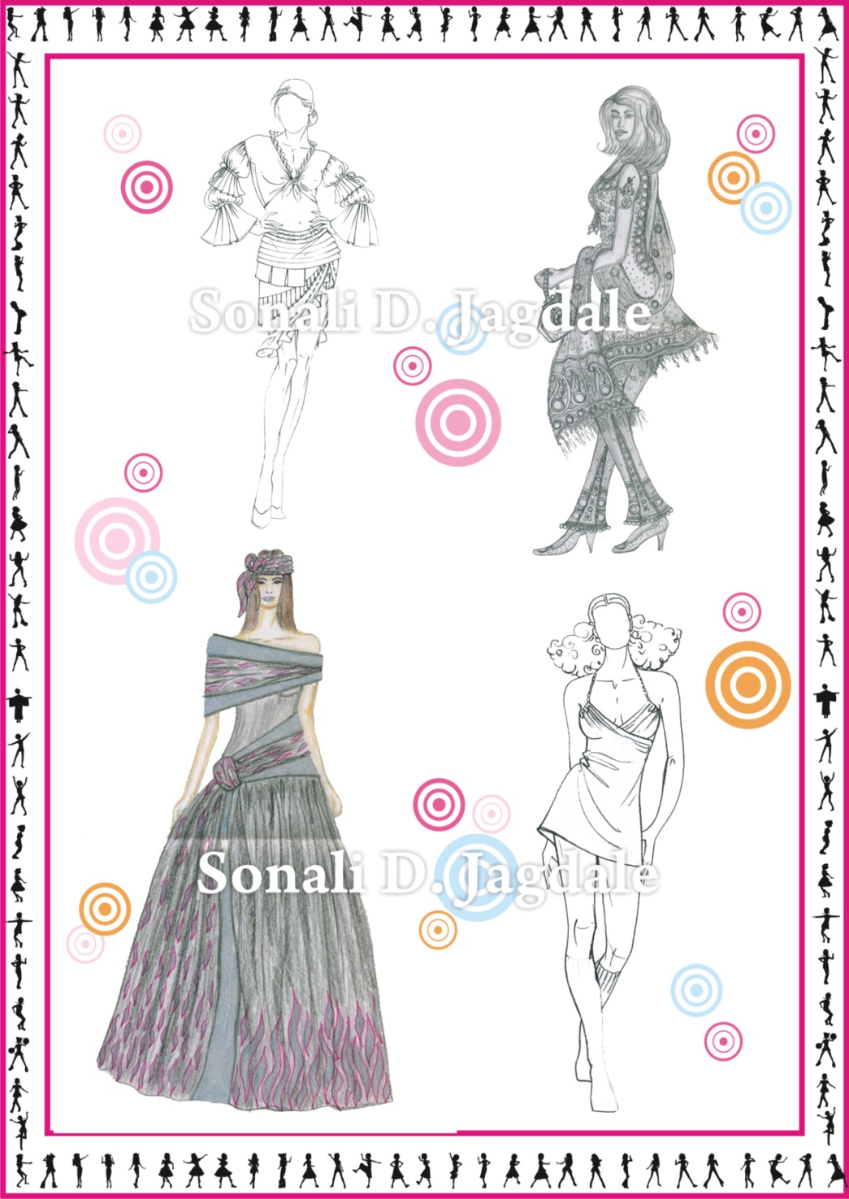


Slide 4
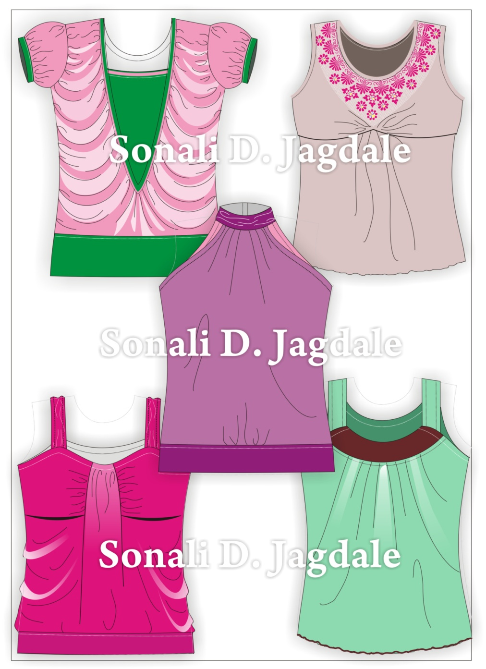


Slide 5
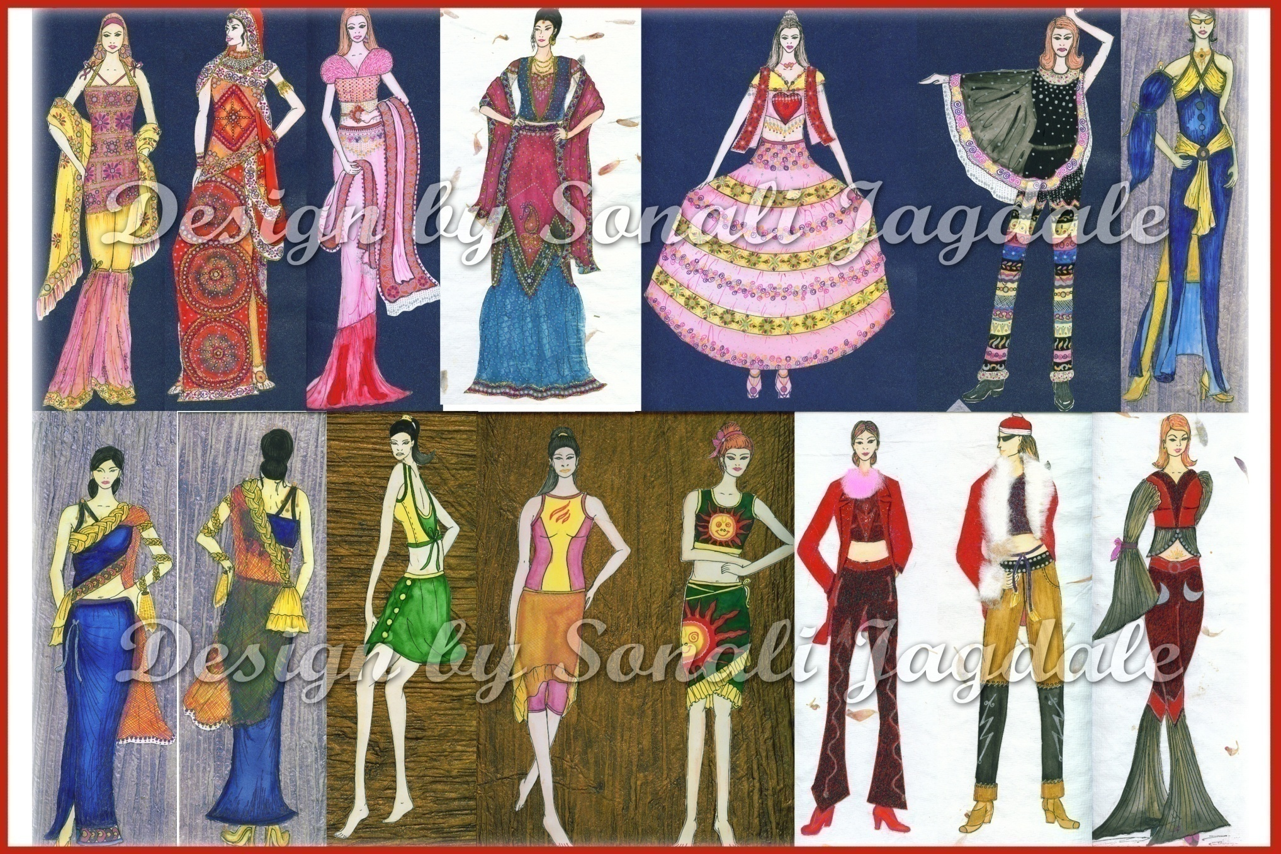

These is some designs to show a very different, trendy & lovely designs for a Charming Girls wearing a Bridals wear, Occasion wear, Trendy Casual wear, Evening wear / Gowns, Vacation wear & also Cool Winter, etc.

Slide 6
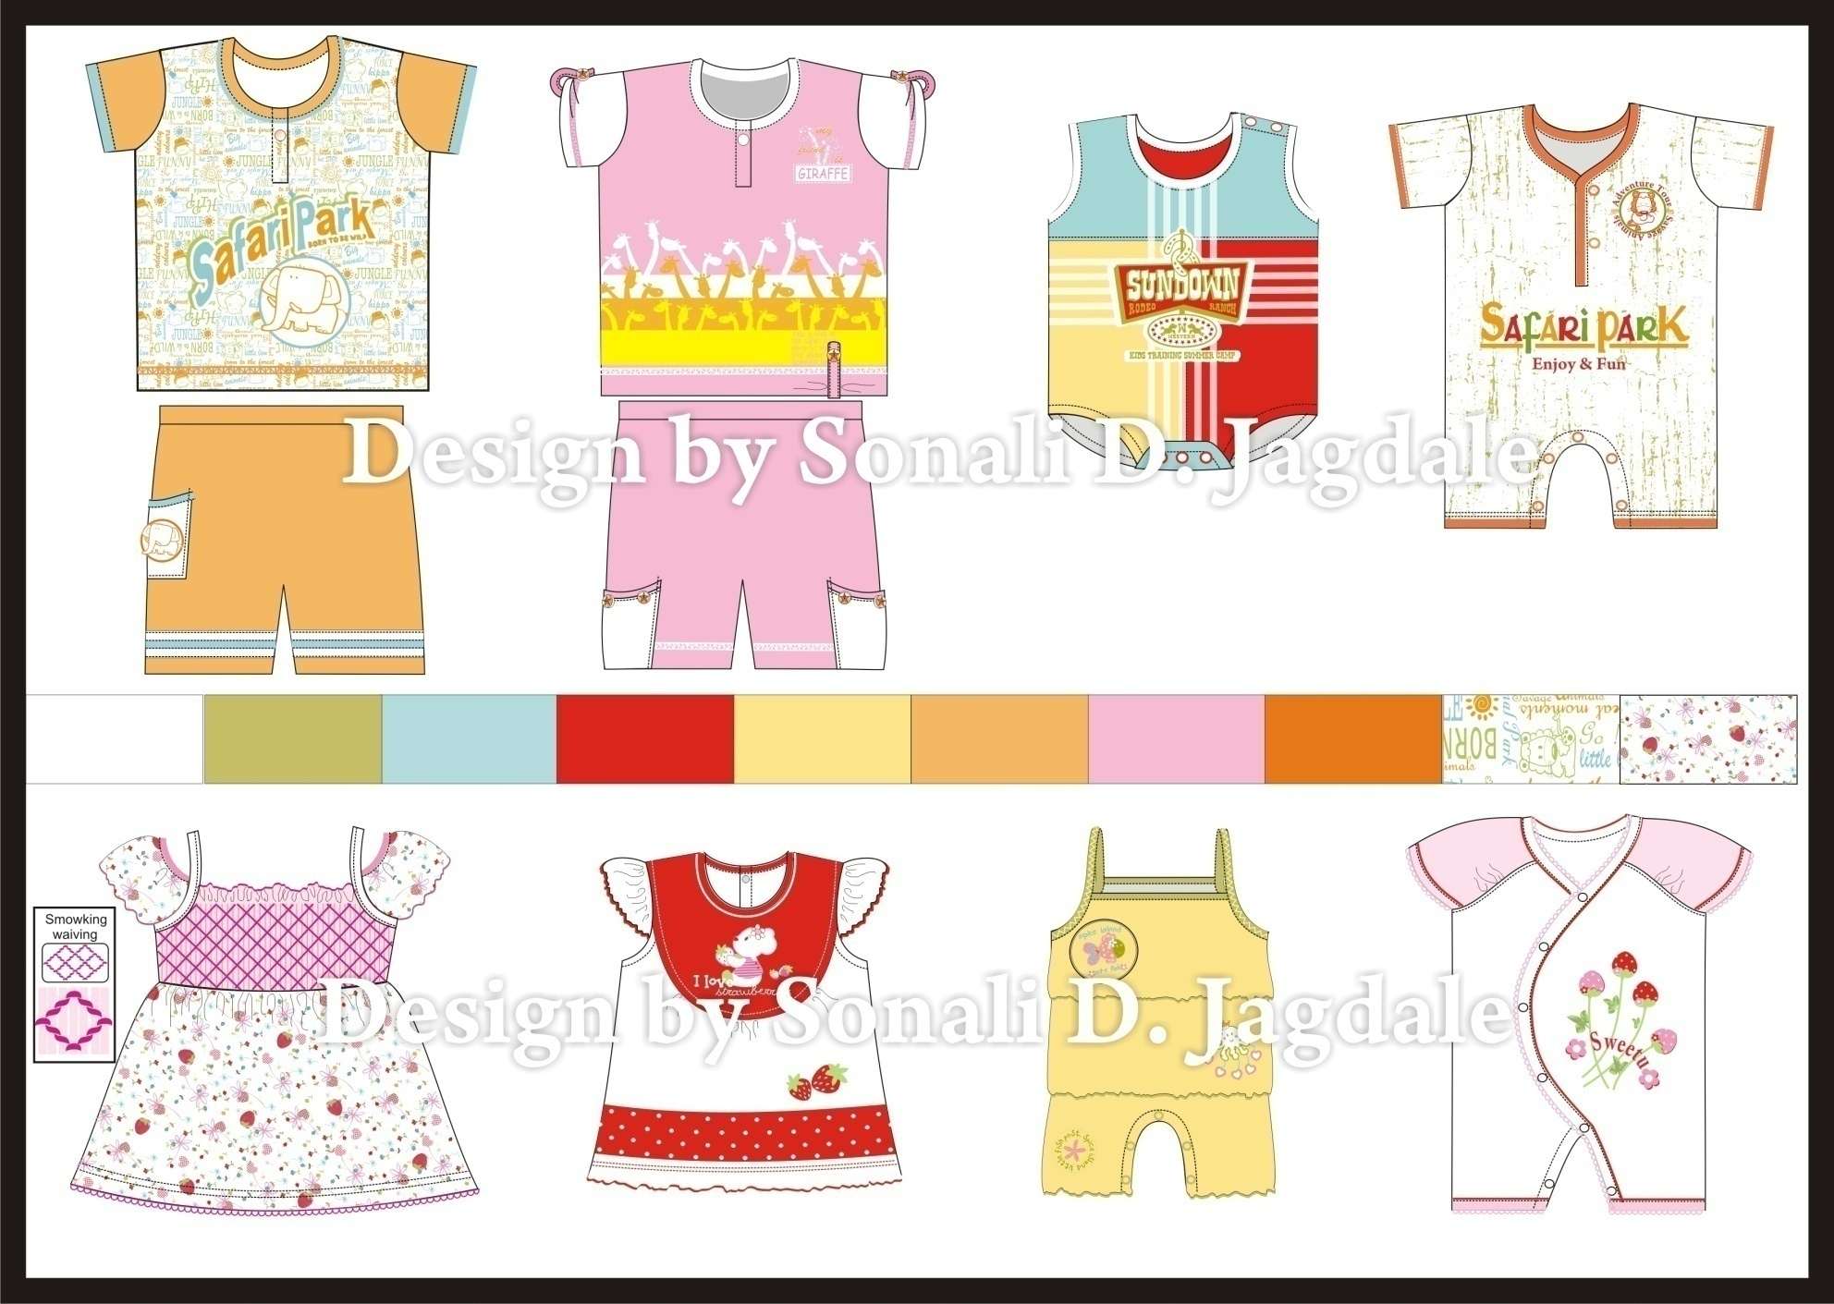
Infant wear

Slide 7
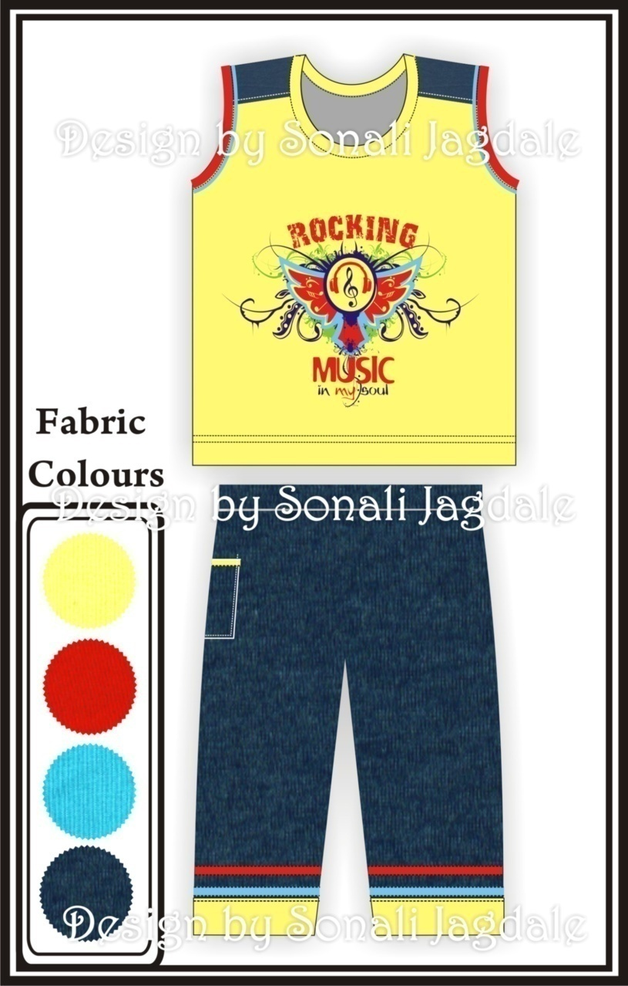
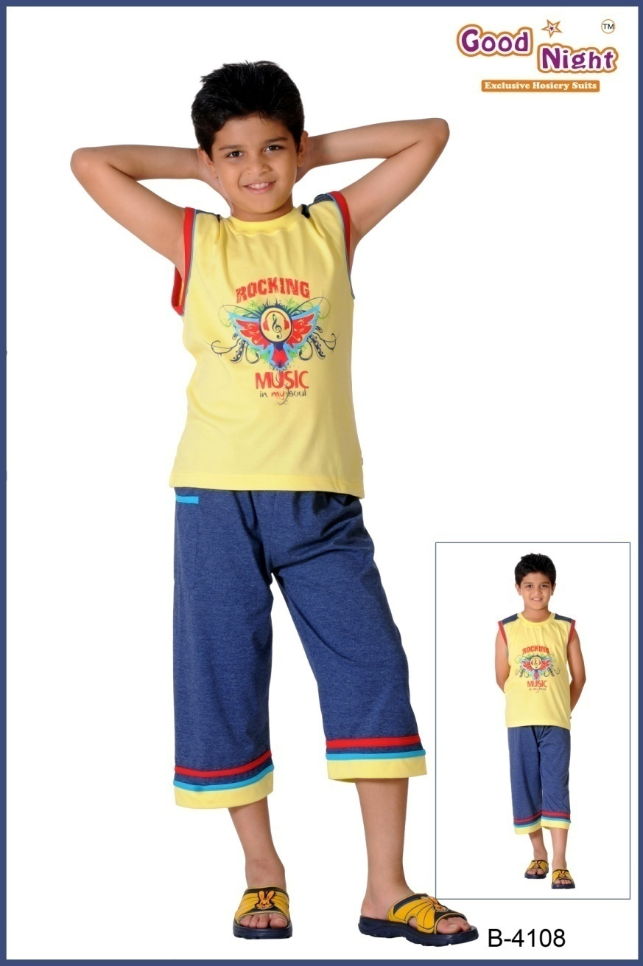
Spring Summer - 2010
www.kaplind.com
Notes:
Kids Night Suits :( www.kaplind.com-Kirti App. Pvt . Ltd. Site, not my) Many stylish & trendy theme are apply to my designs like Rocking music, Rider, etc. in boy’s & Butterfly garden, Angel, Summer fun, Ice cream, Butterfly Angel ,..etc.

Slide 8
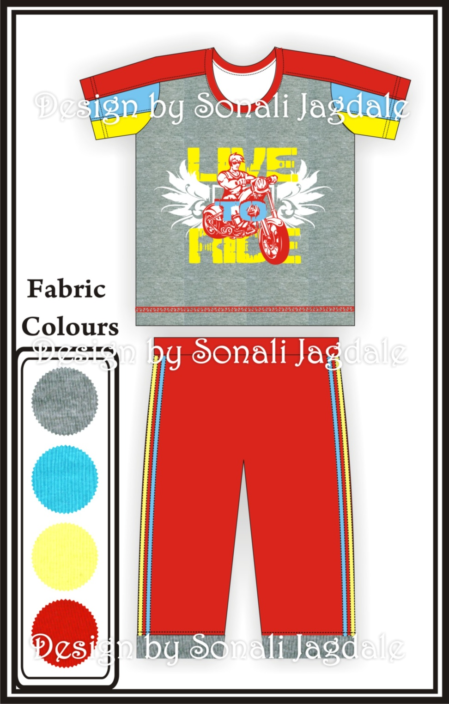
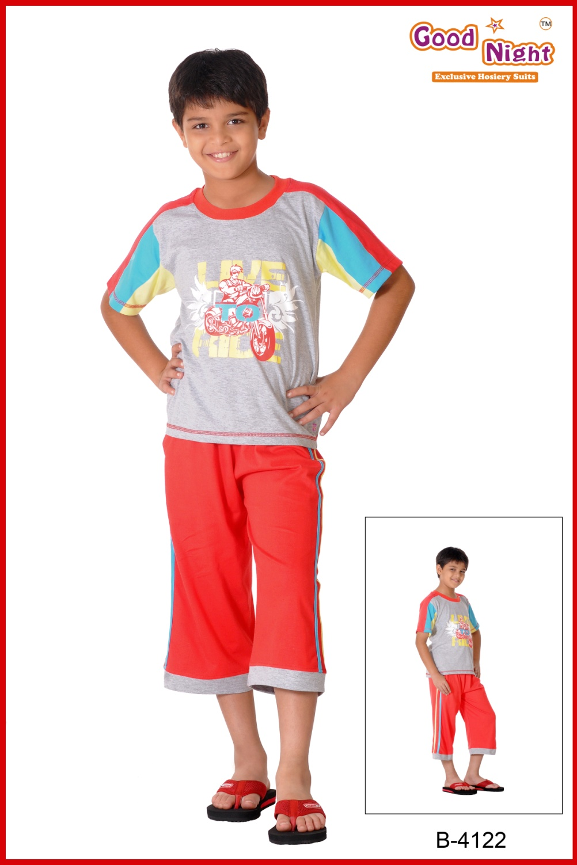
www.kaplind.com

Slide 9
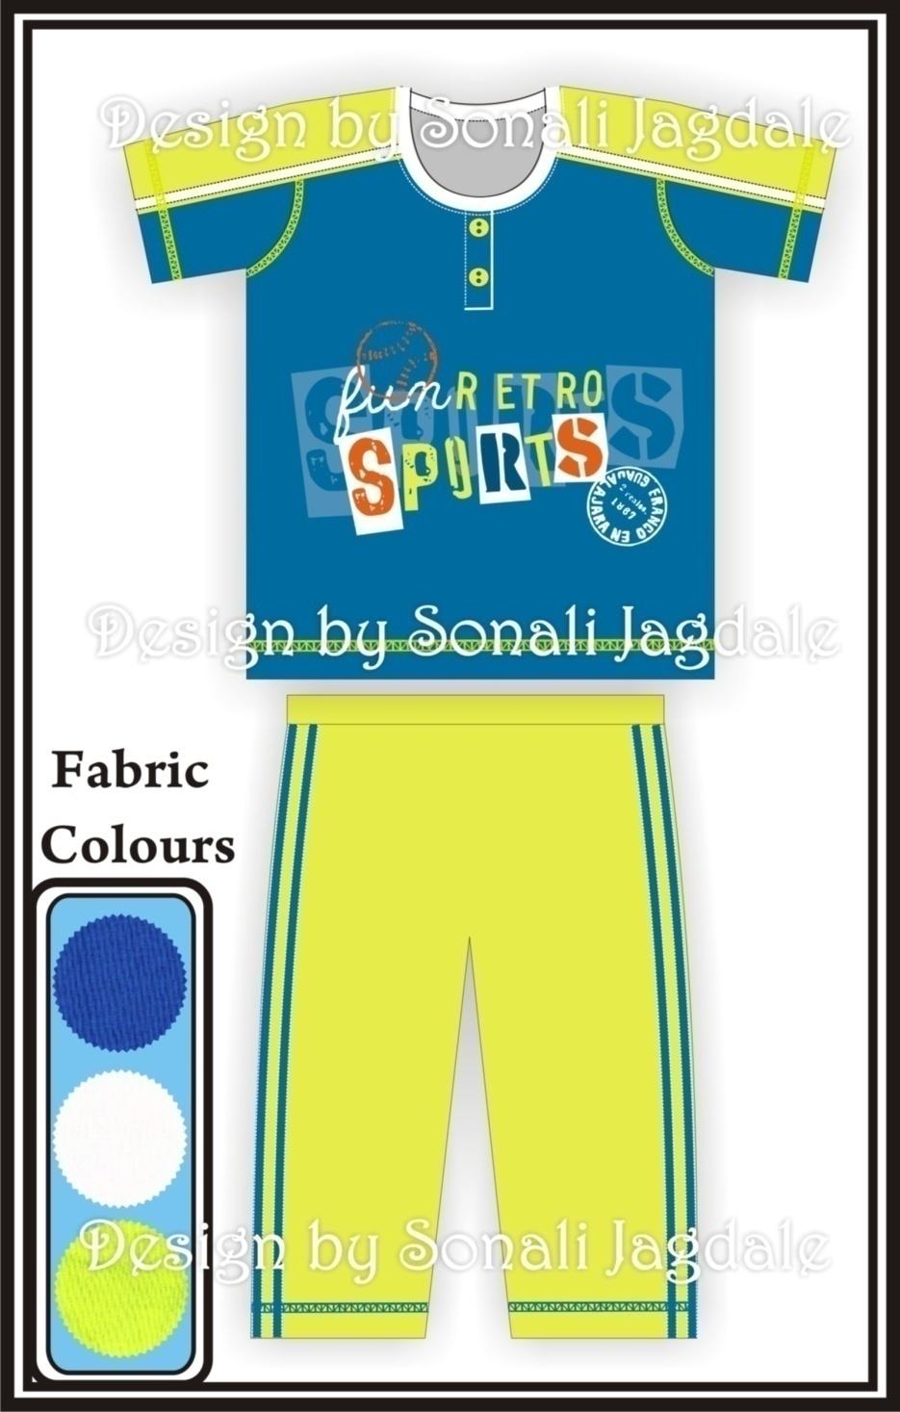
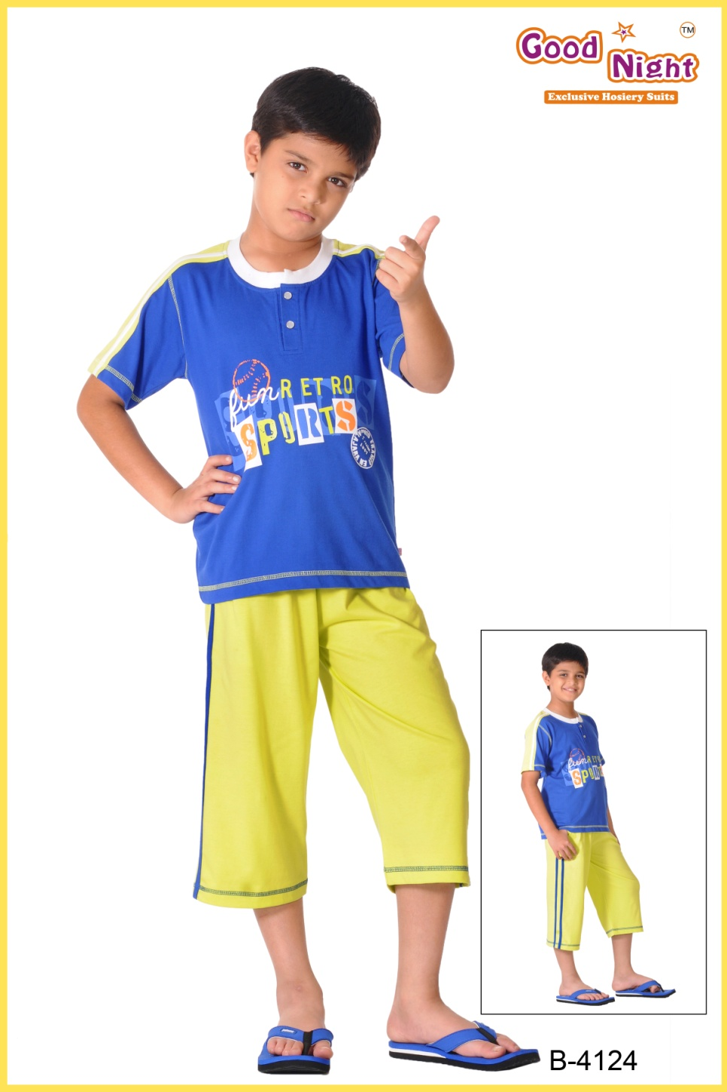
www.kaplind.com

Slide 10
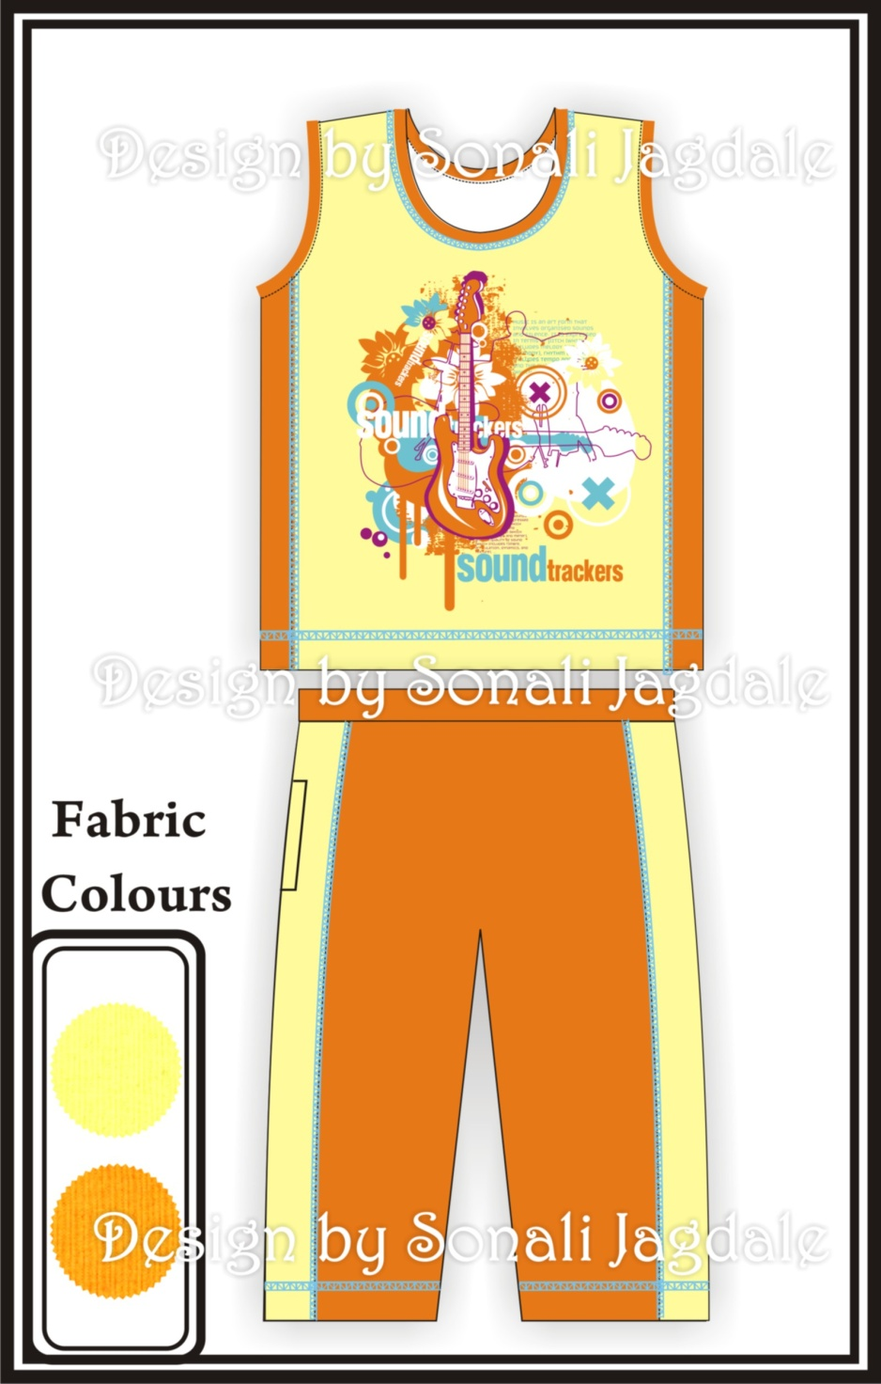
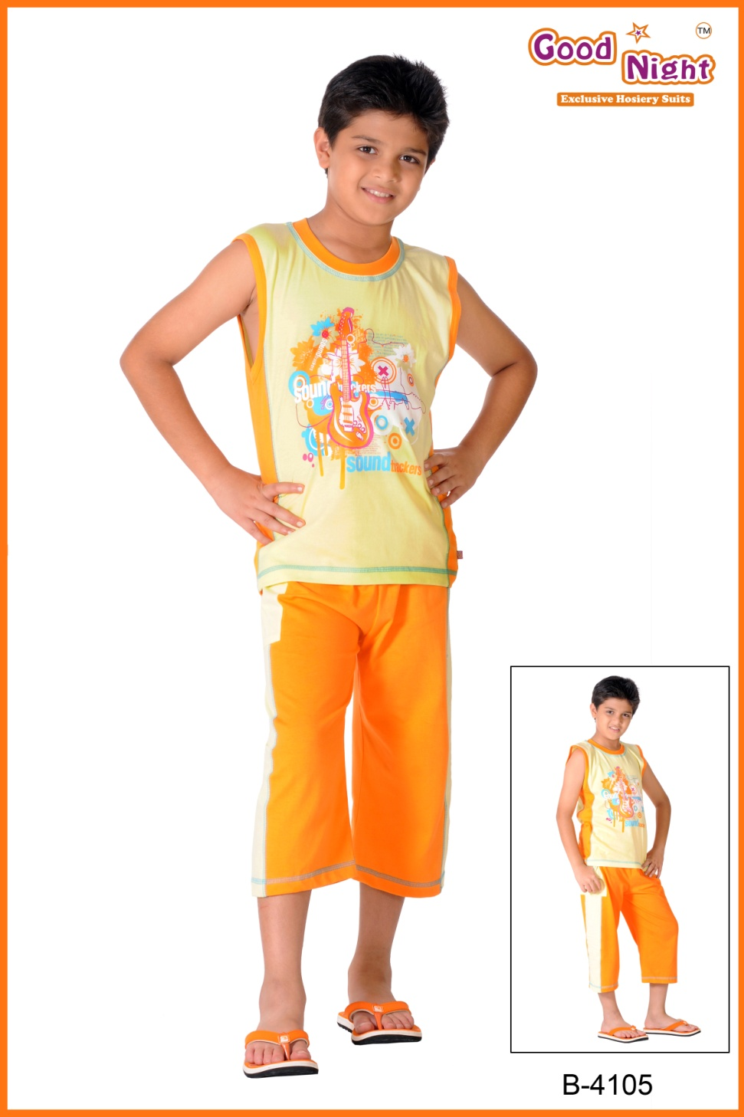
www.kaplind.com

Slide 11
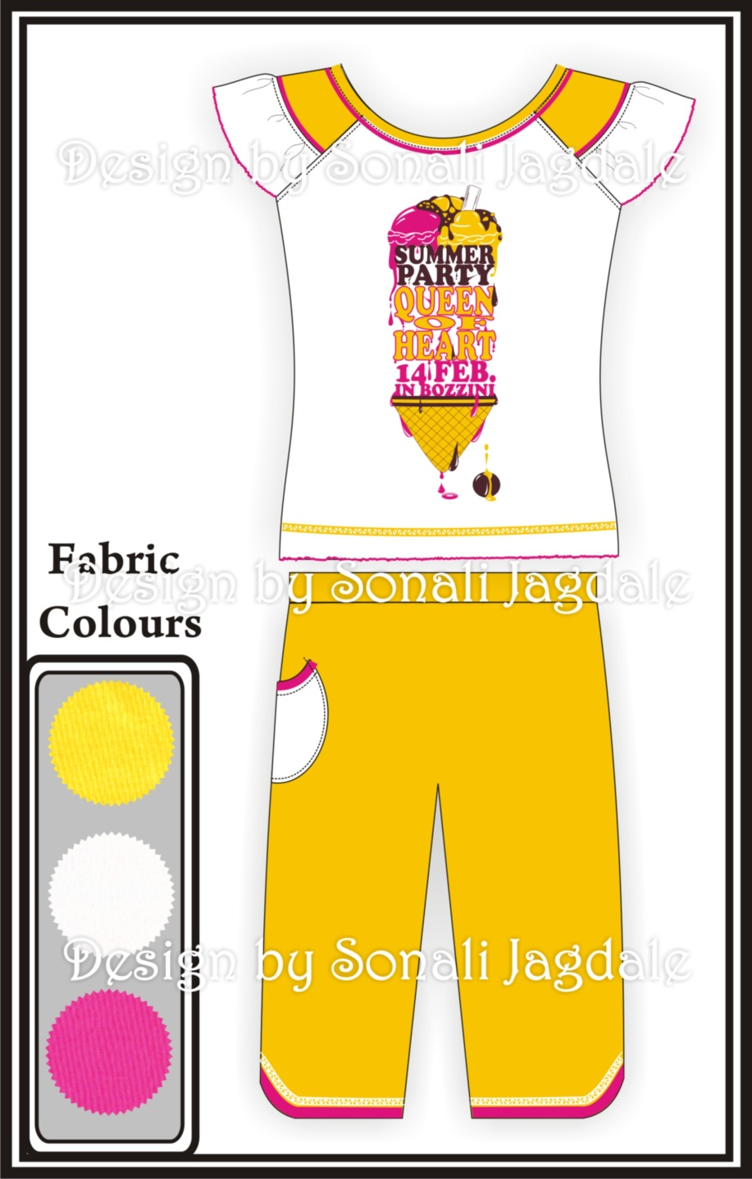
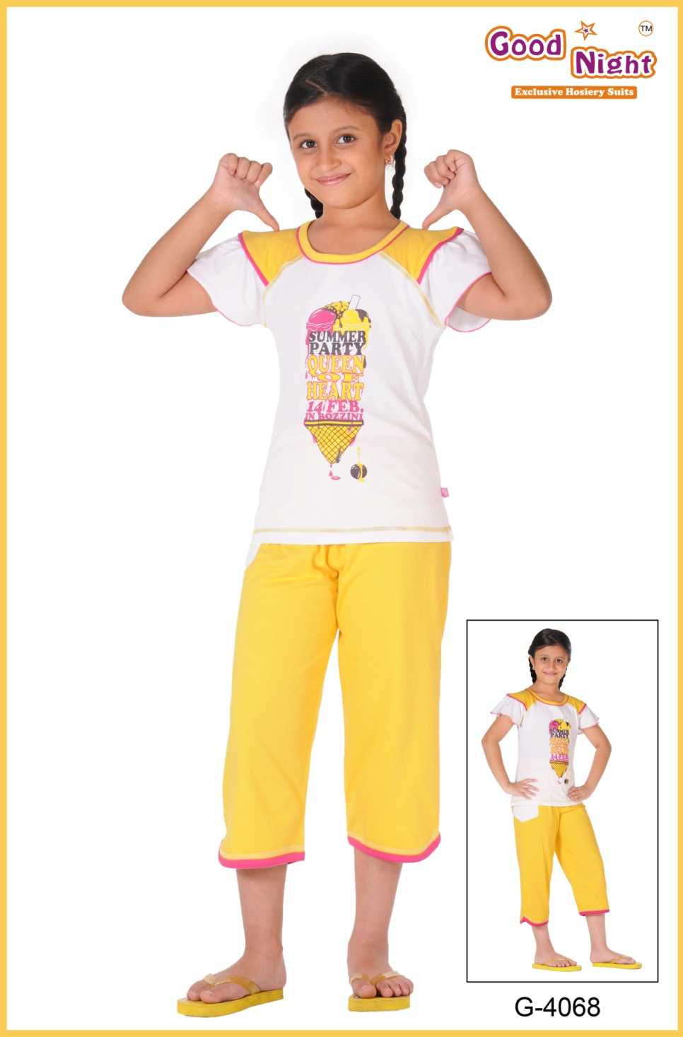
www.kaplind.com

Slide 12
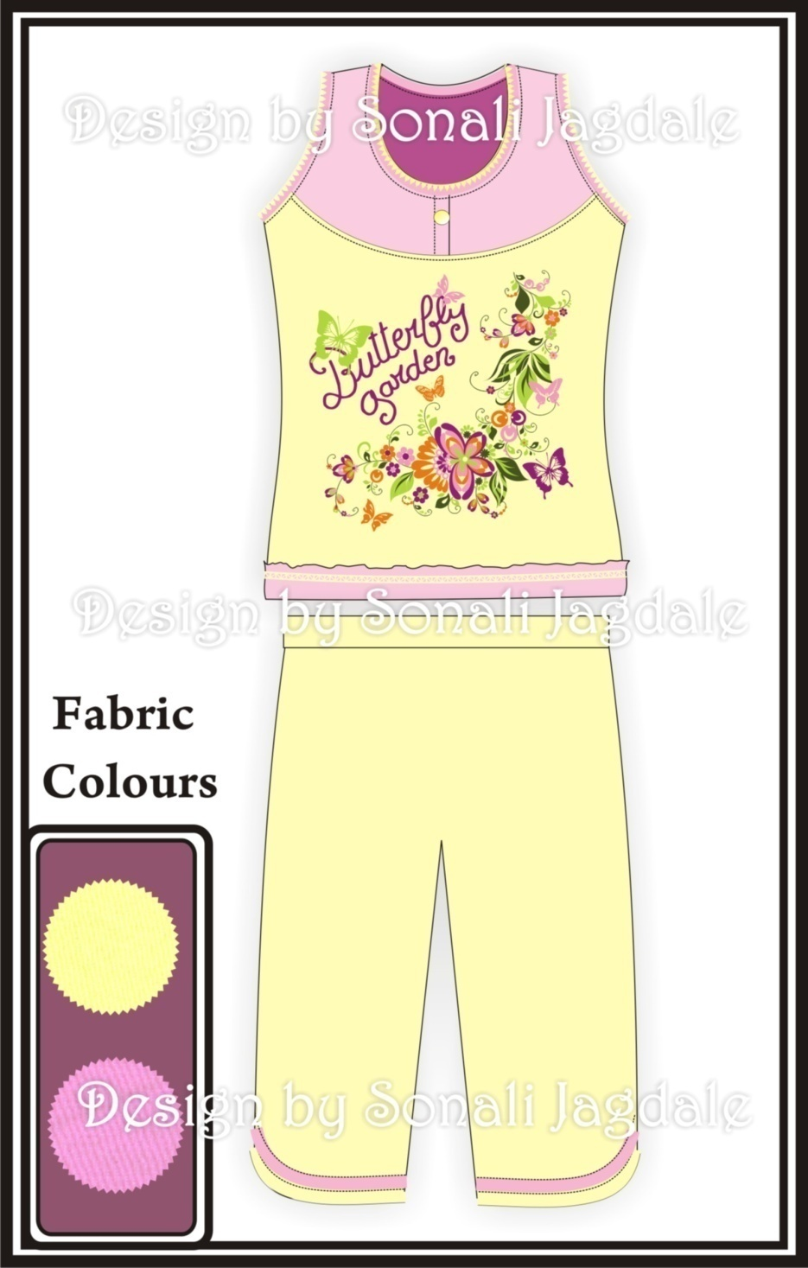
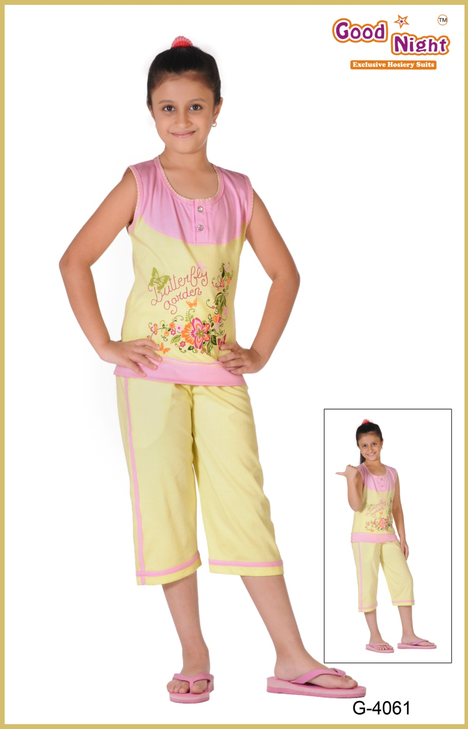
www.kaplind.com

Slide 13
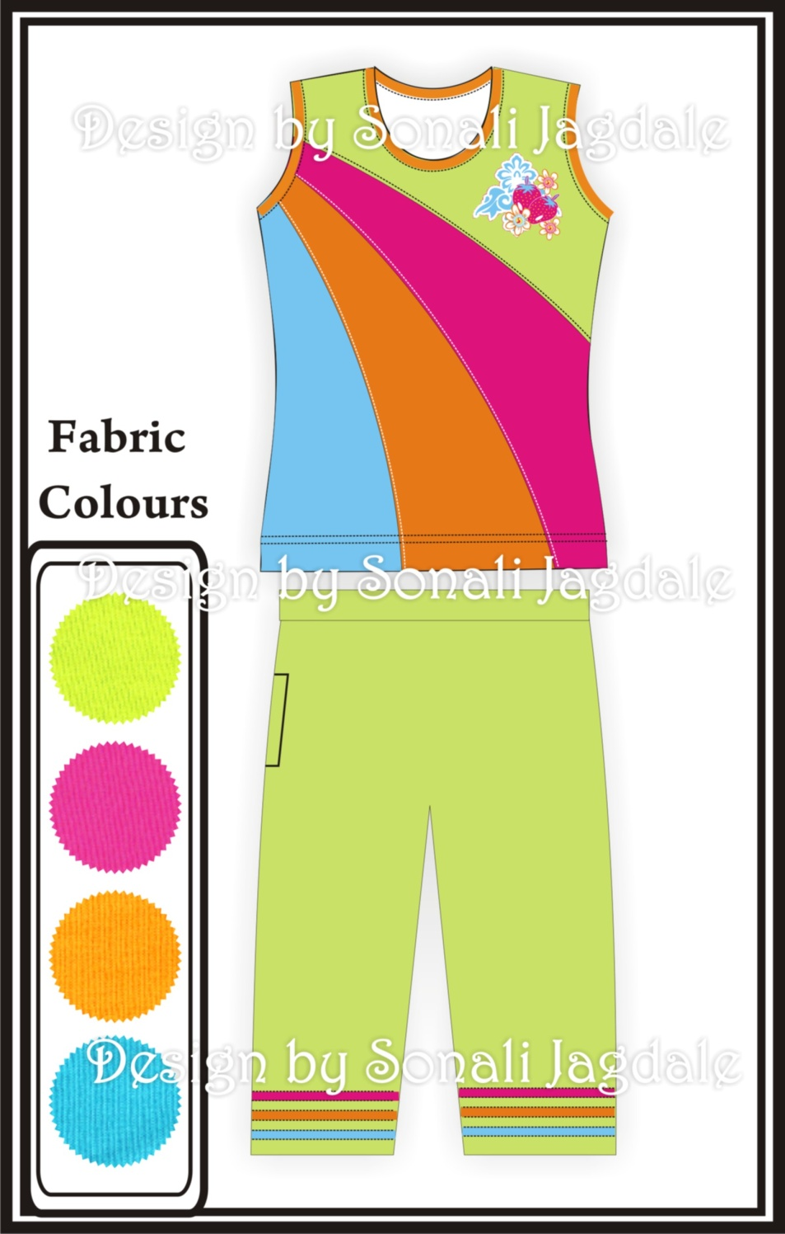
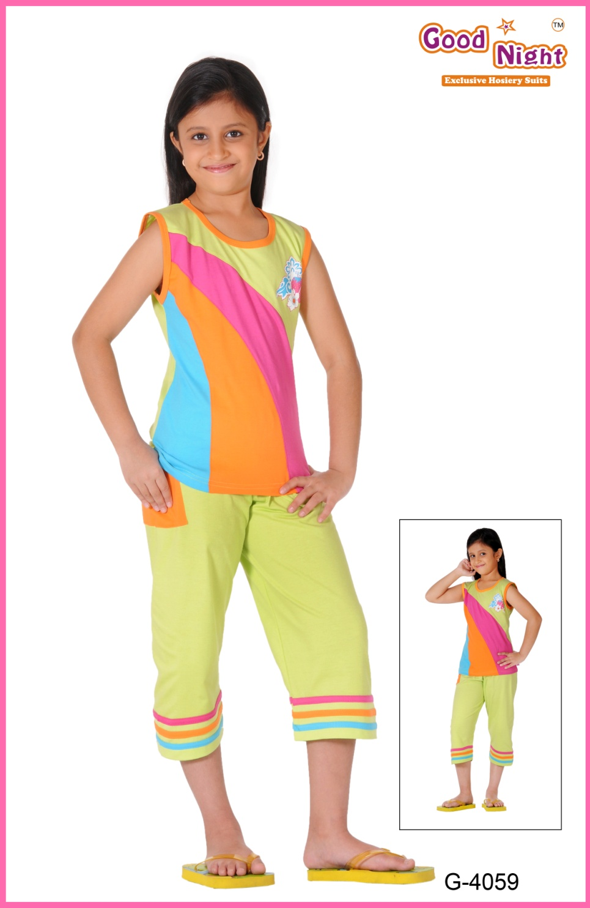
www.kaplind.com

Slide 14
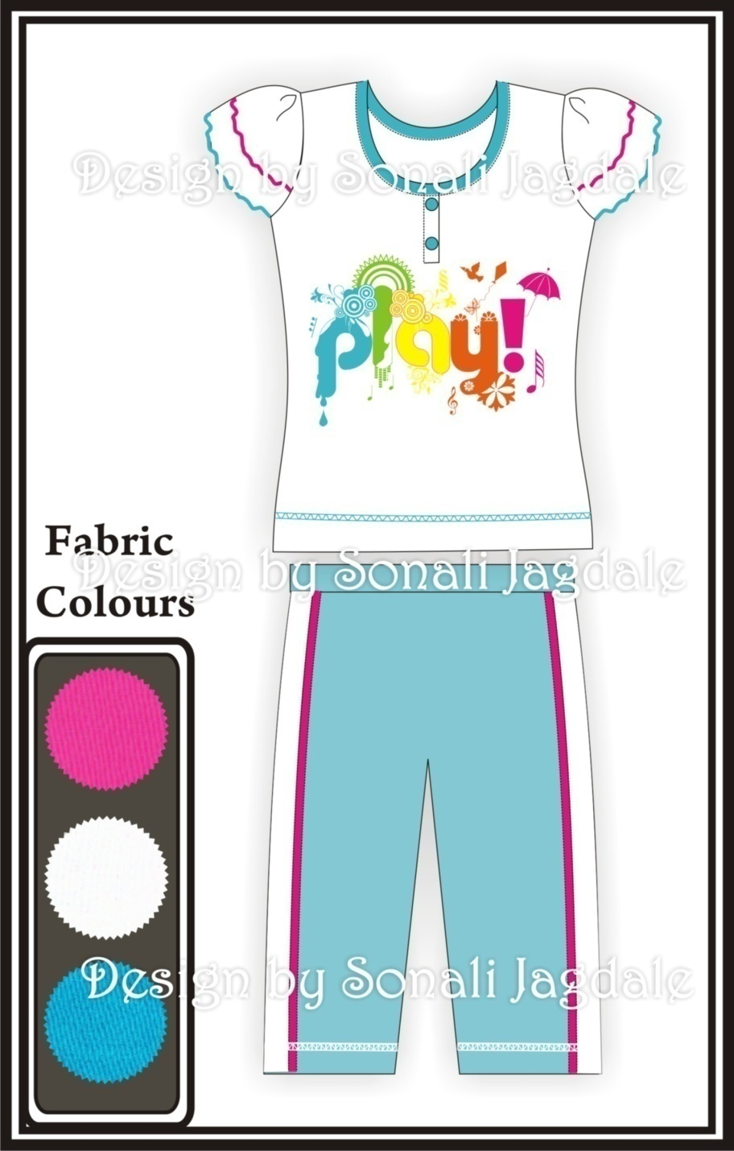
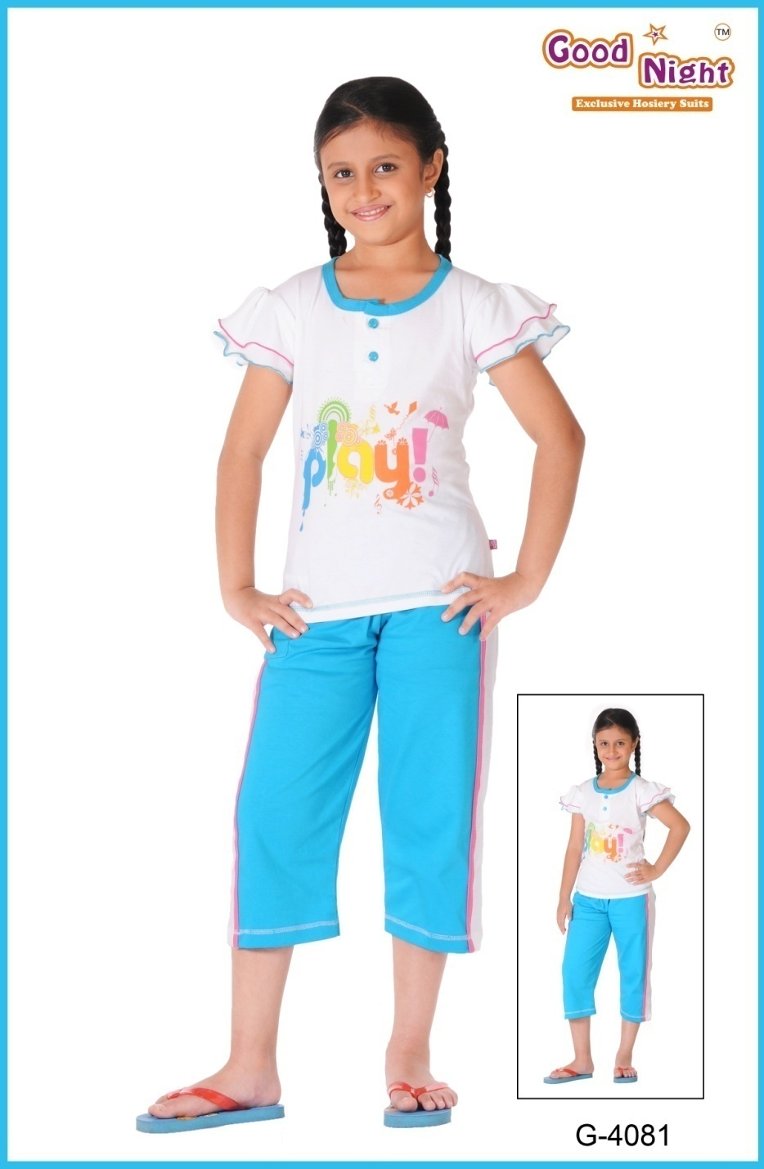
www.kaplind.com

Slide 15
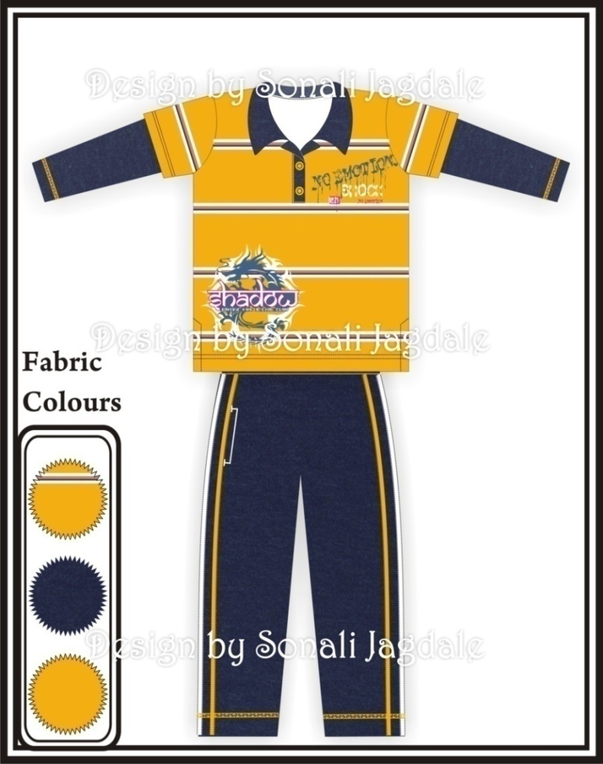
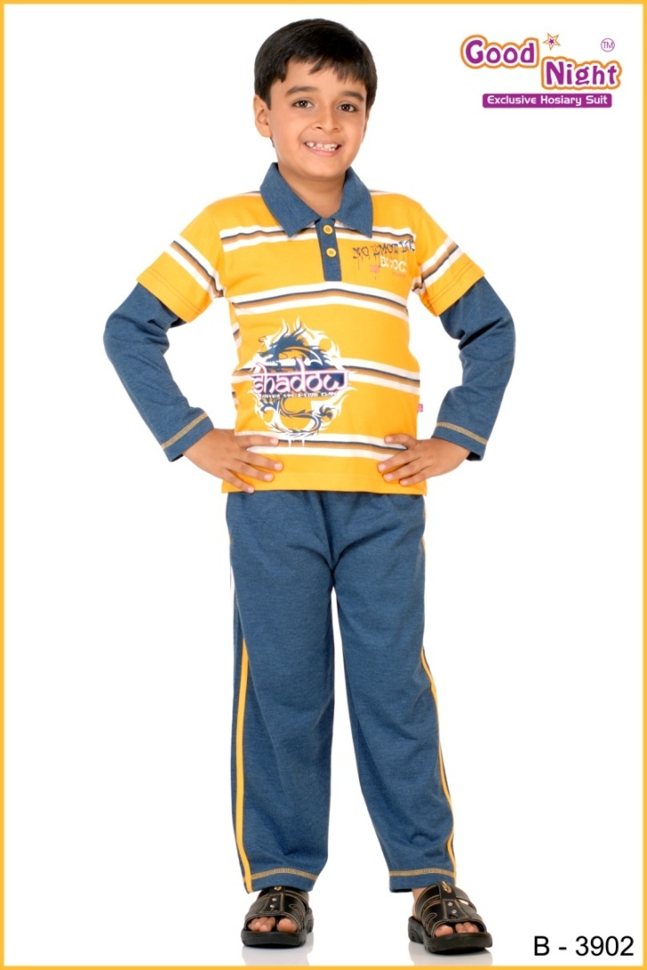
Autumn Winter Collection - 2009
www.kaplind.com

Slide 16
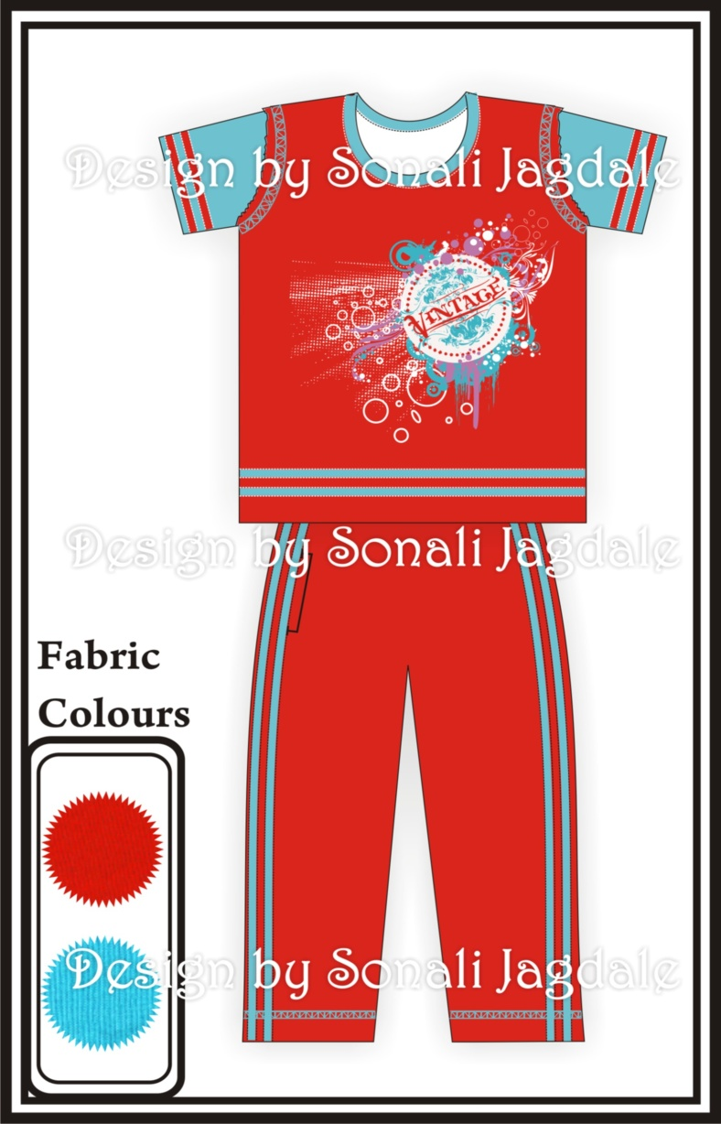
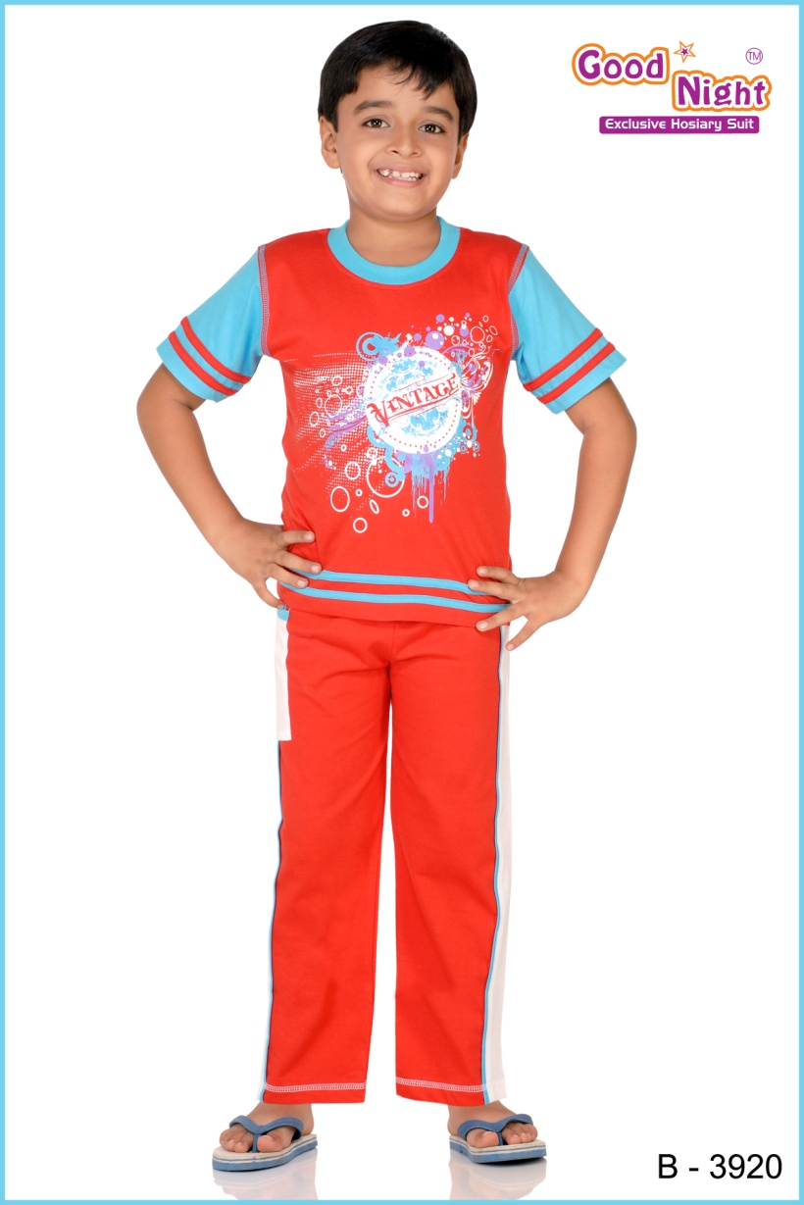
www.kaplind.com

Slide 17
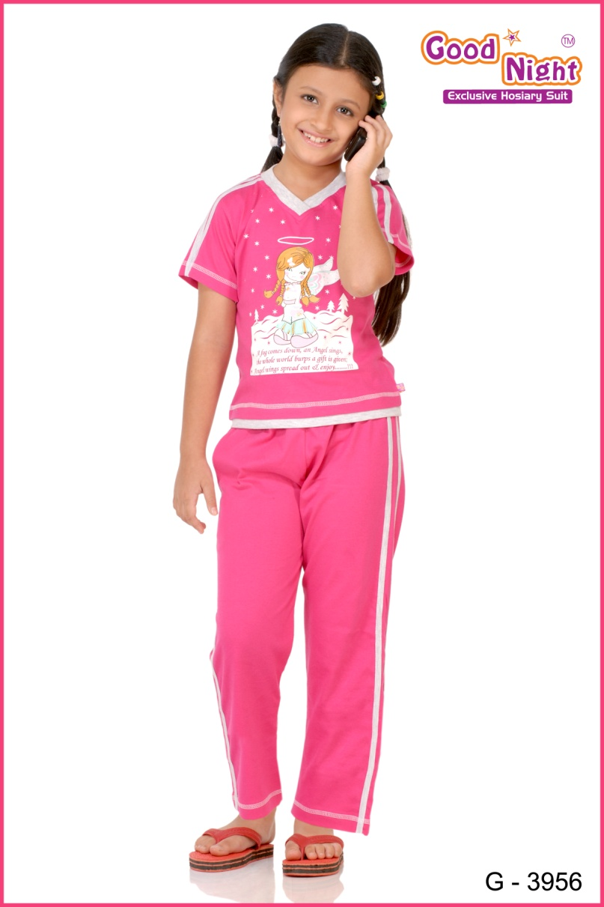
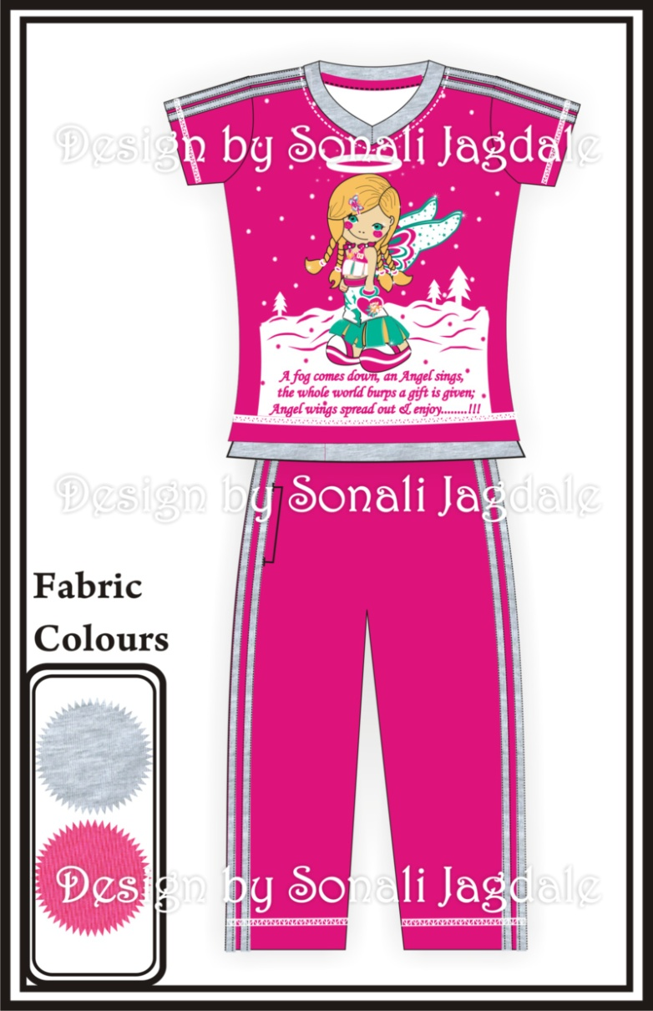
www.kaplind.com

Slide 18
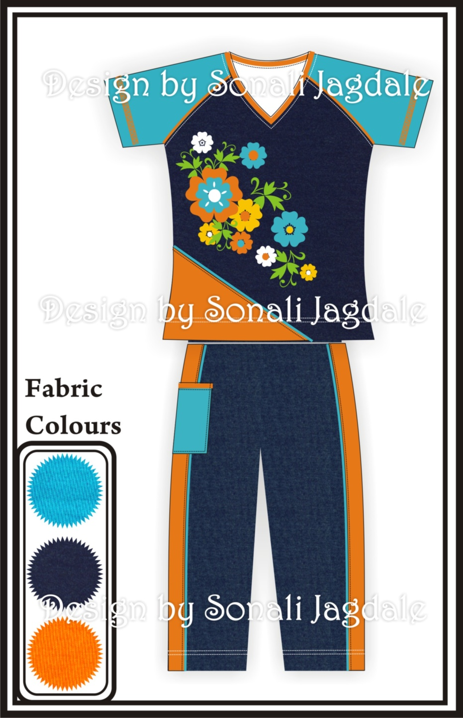
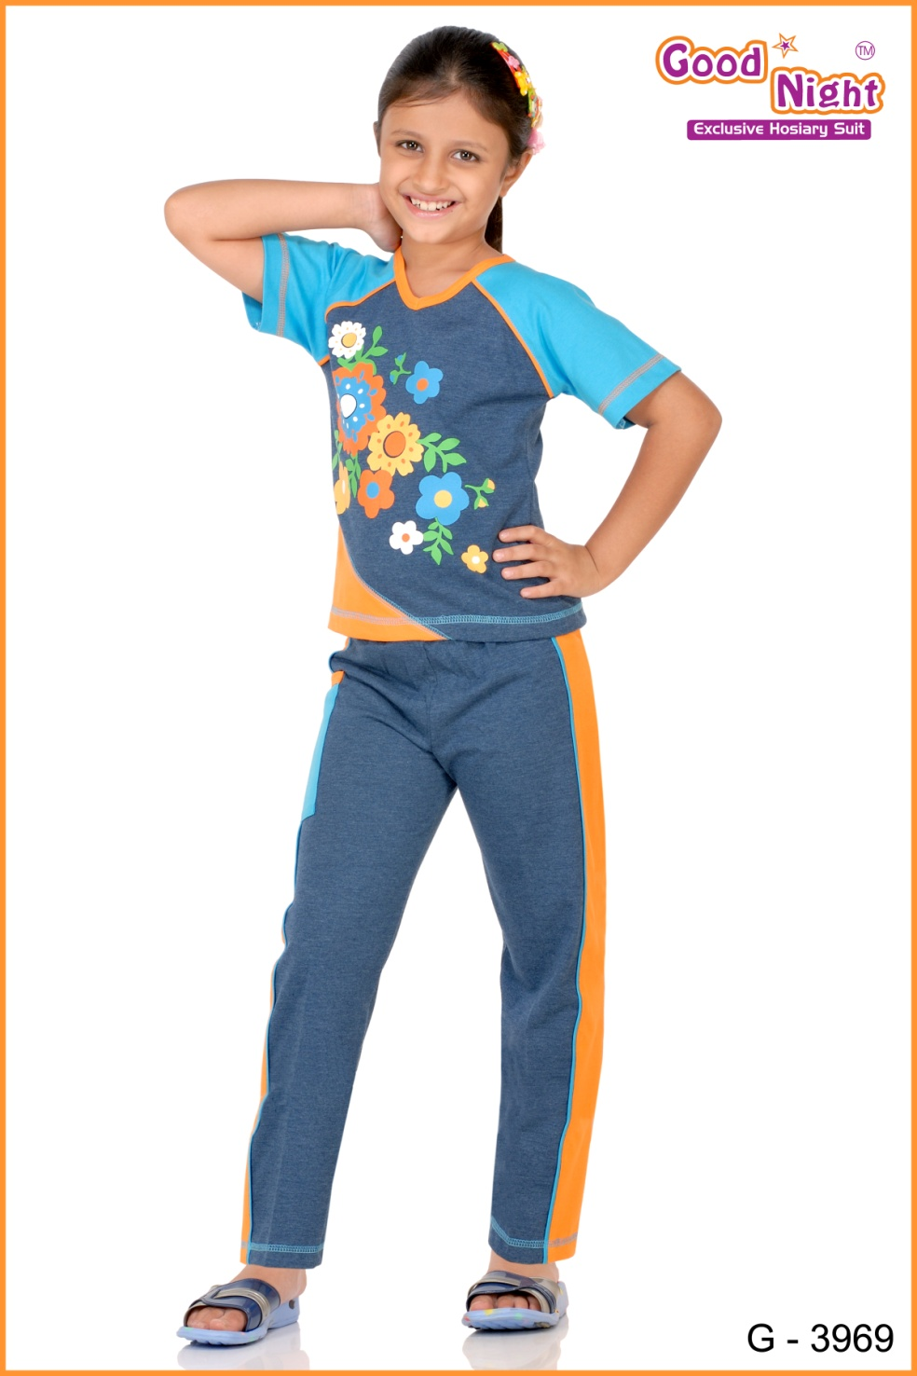
www.kaplind.com

Slide 19
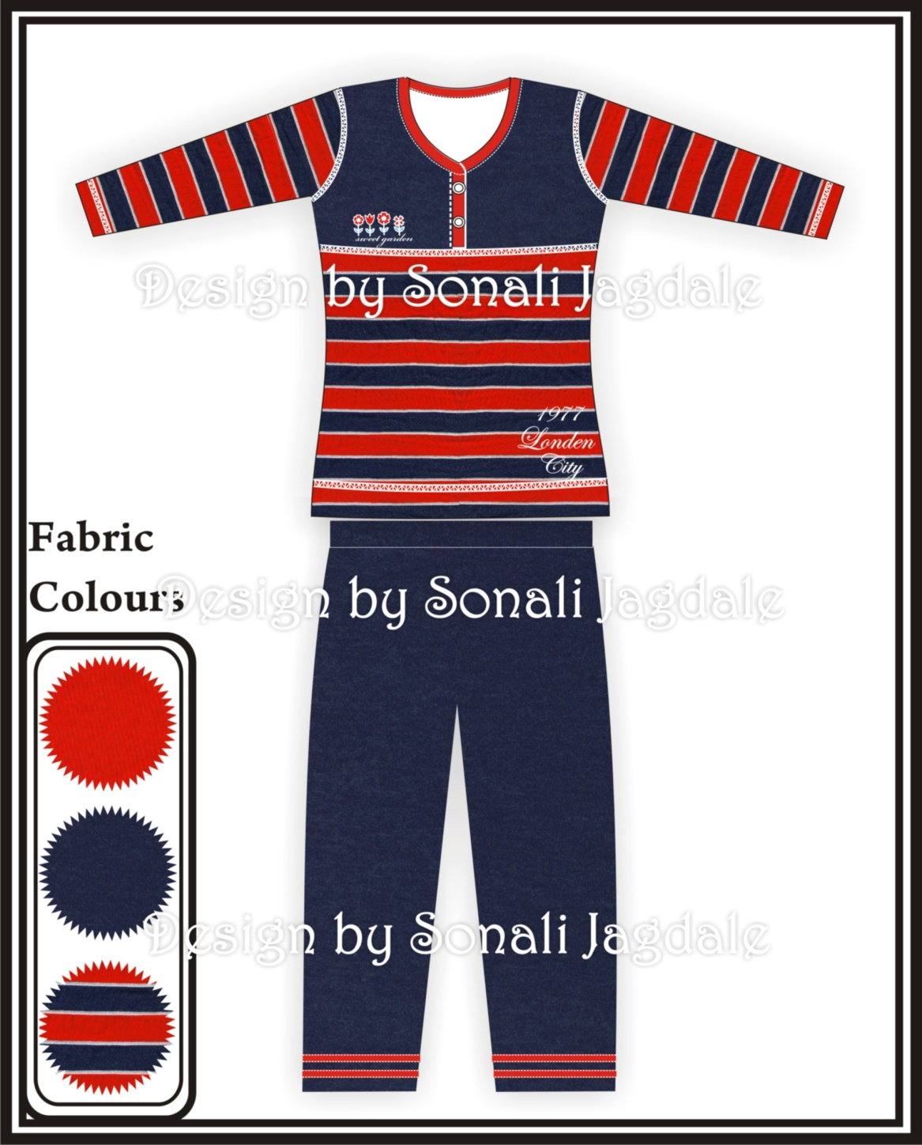
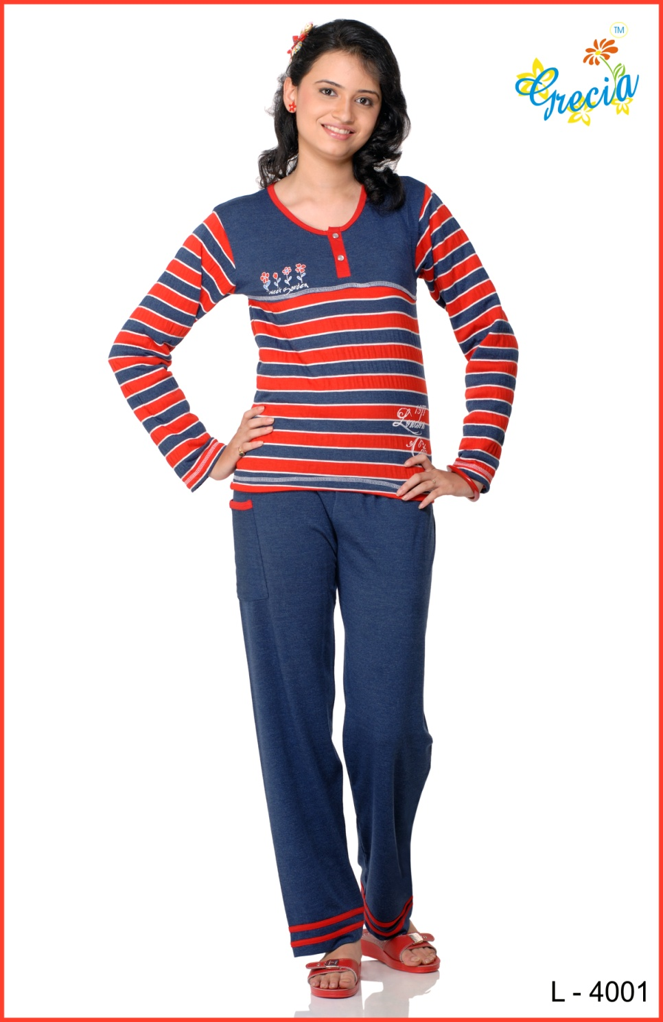
www.kaplind.com

Slide 20
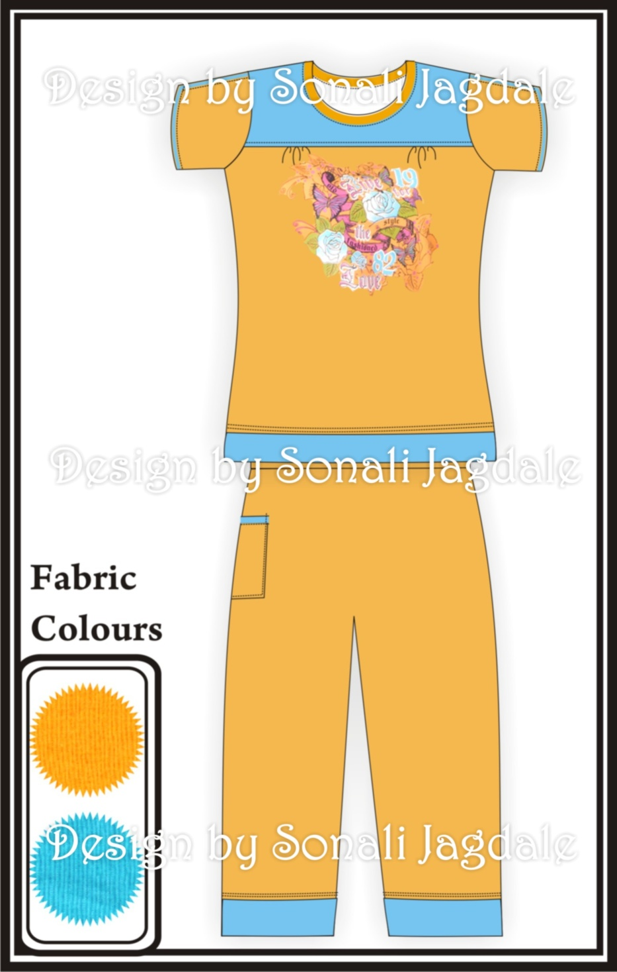
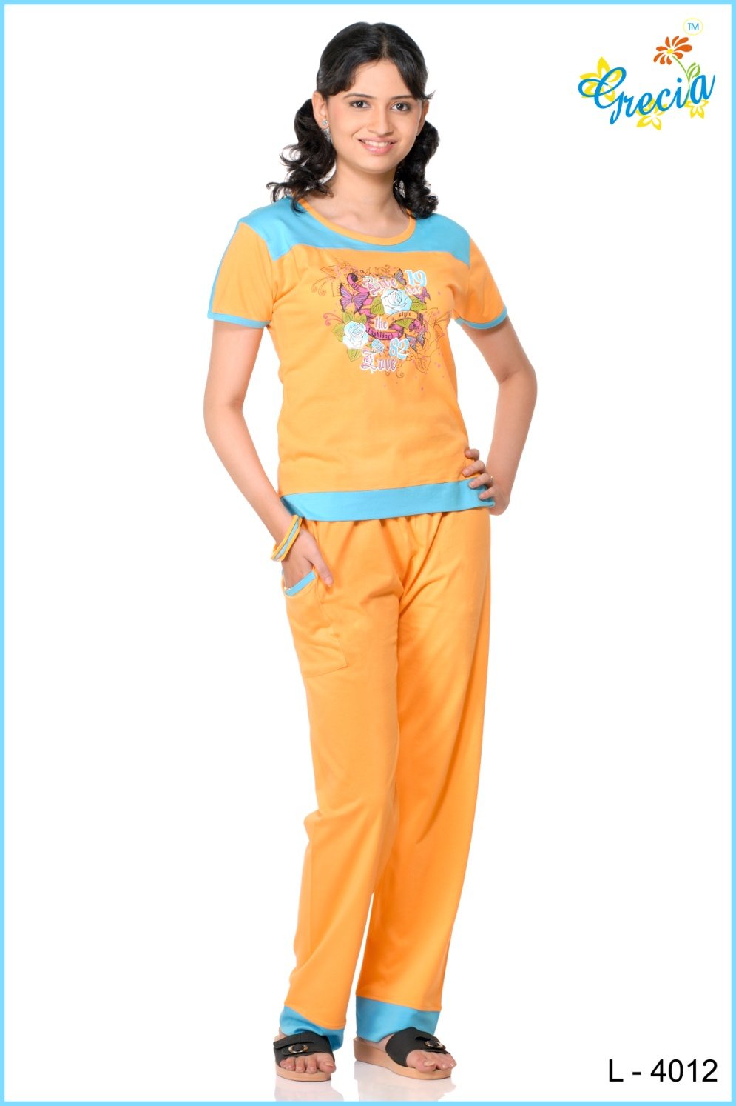
www.kaplind.com

Slide 21
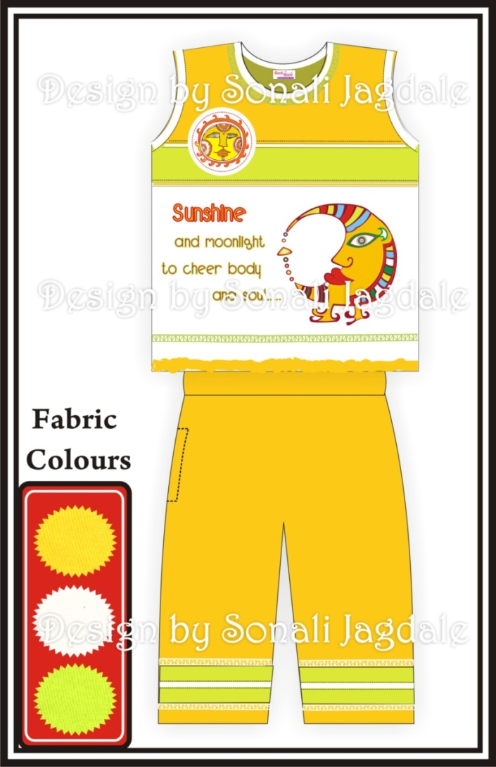

Spring Summer - 2009
www.kaplind.com

Slide 22
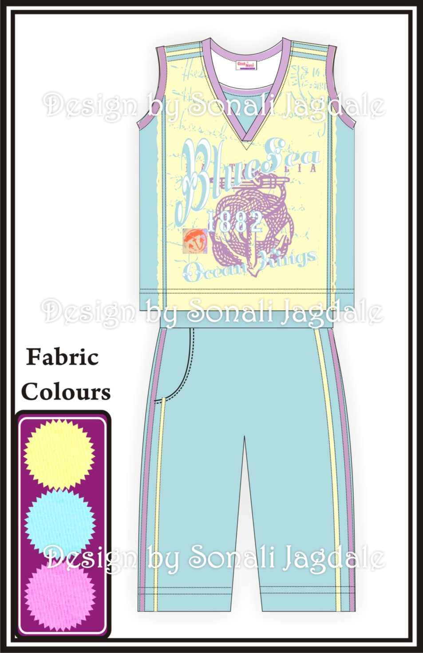
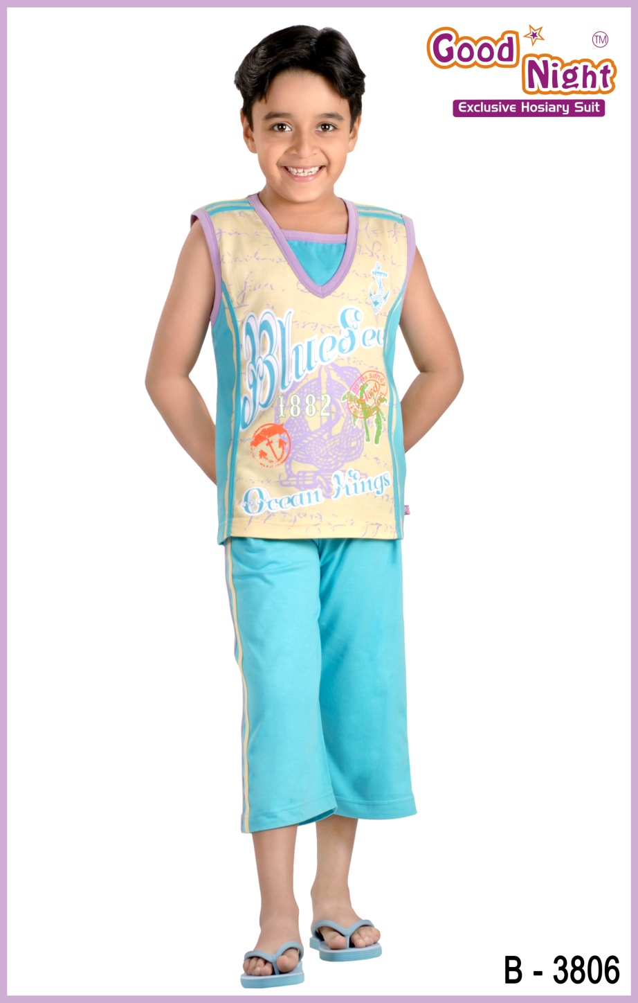
www.kaplind.com

Slide 23
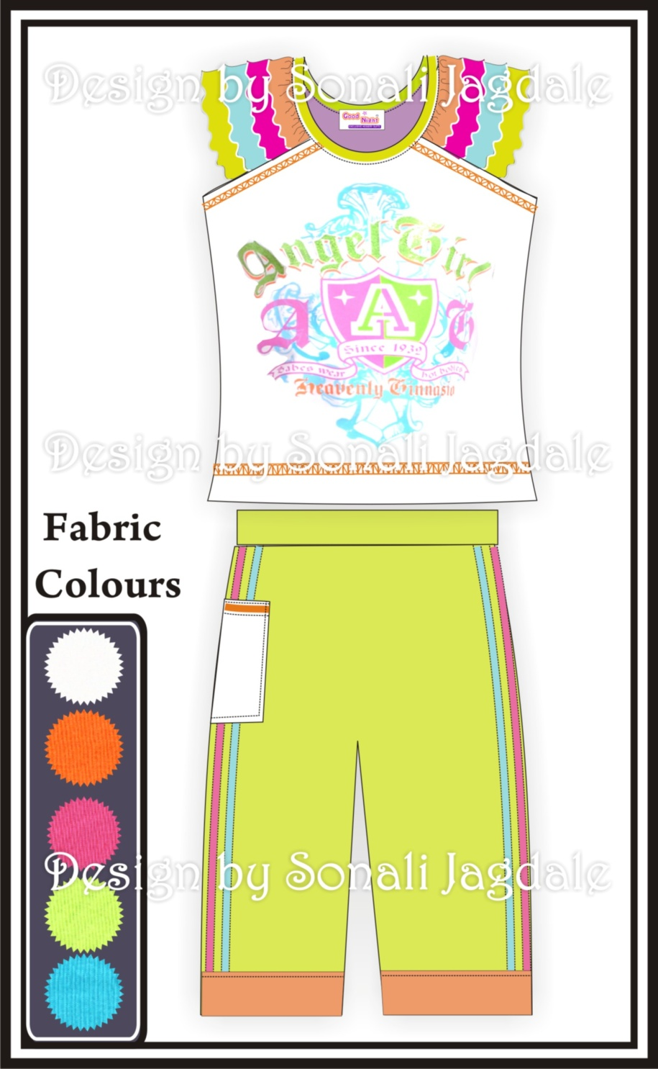
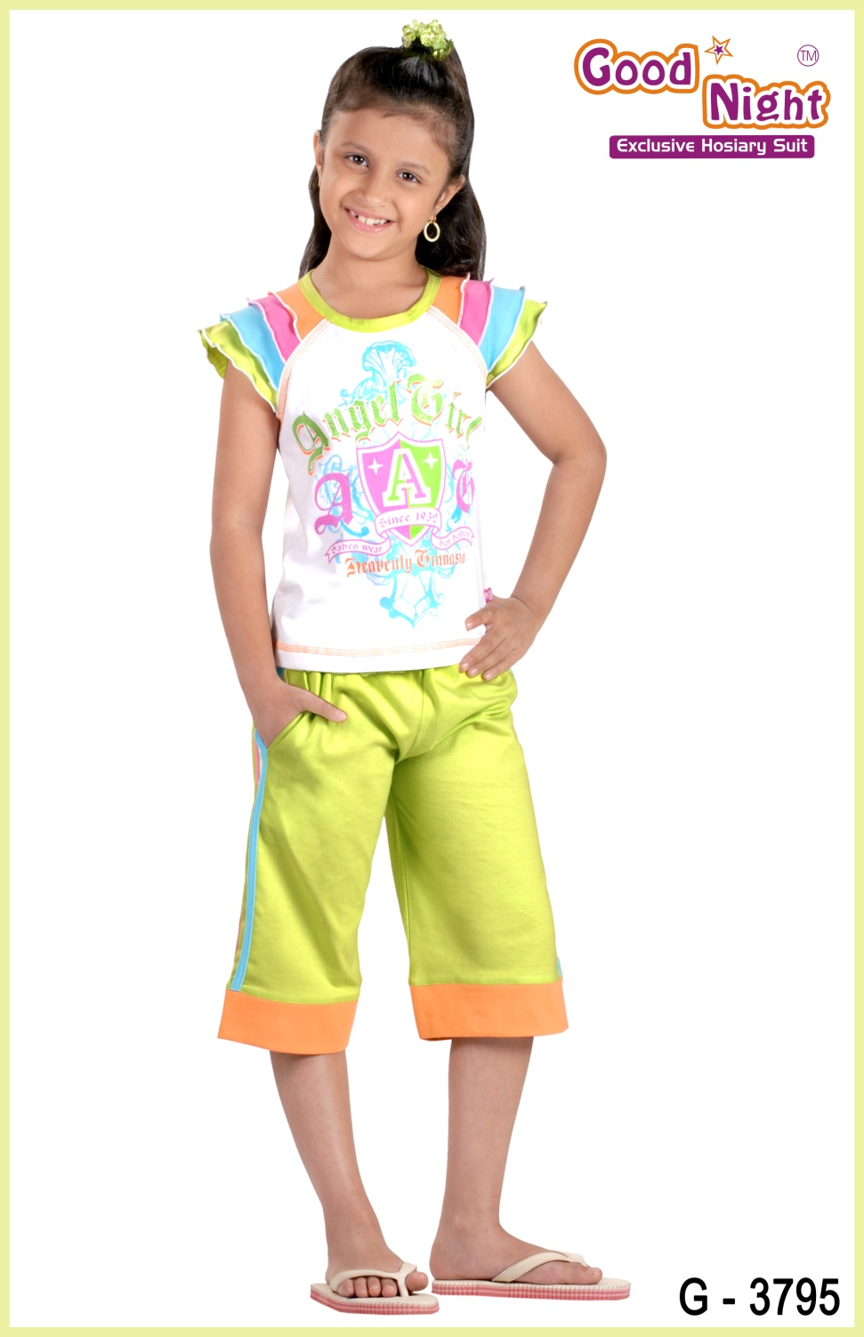
www.kaplind.com

Slide 24
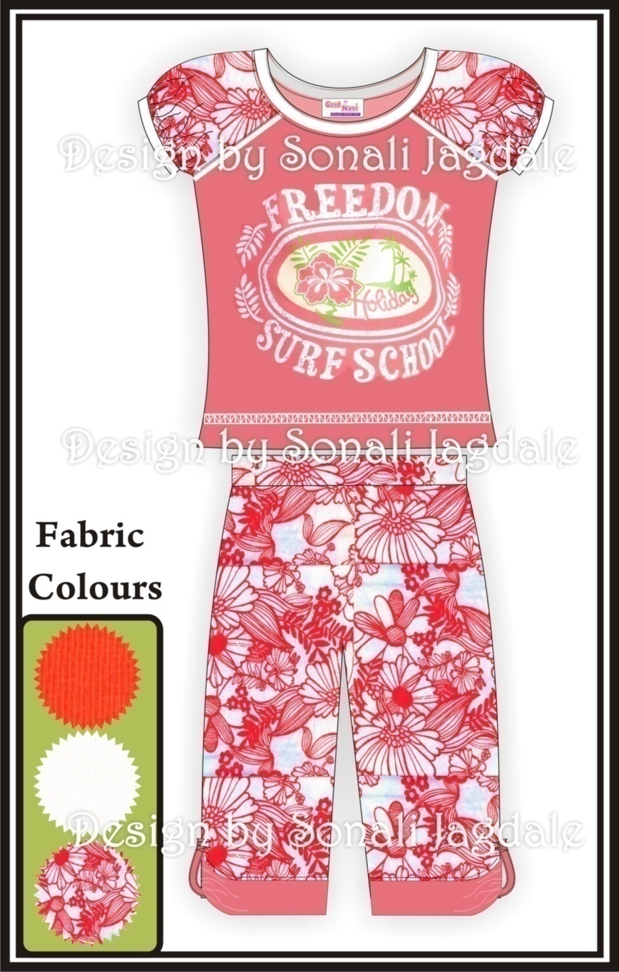
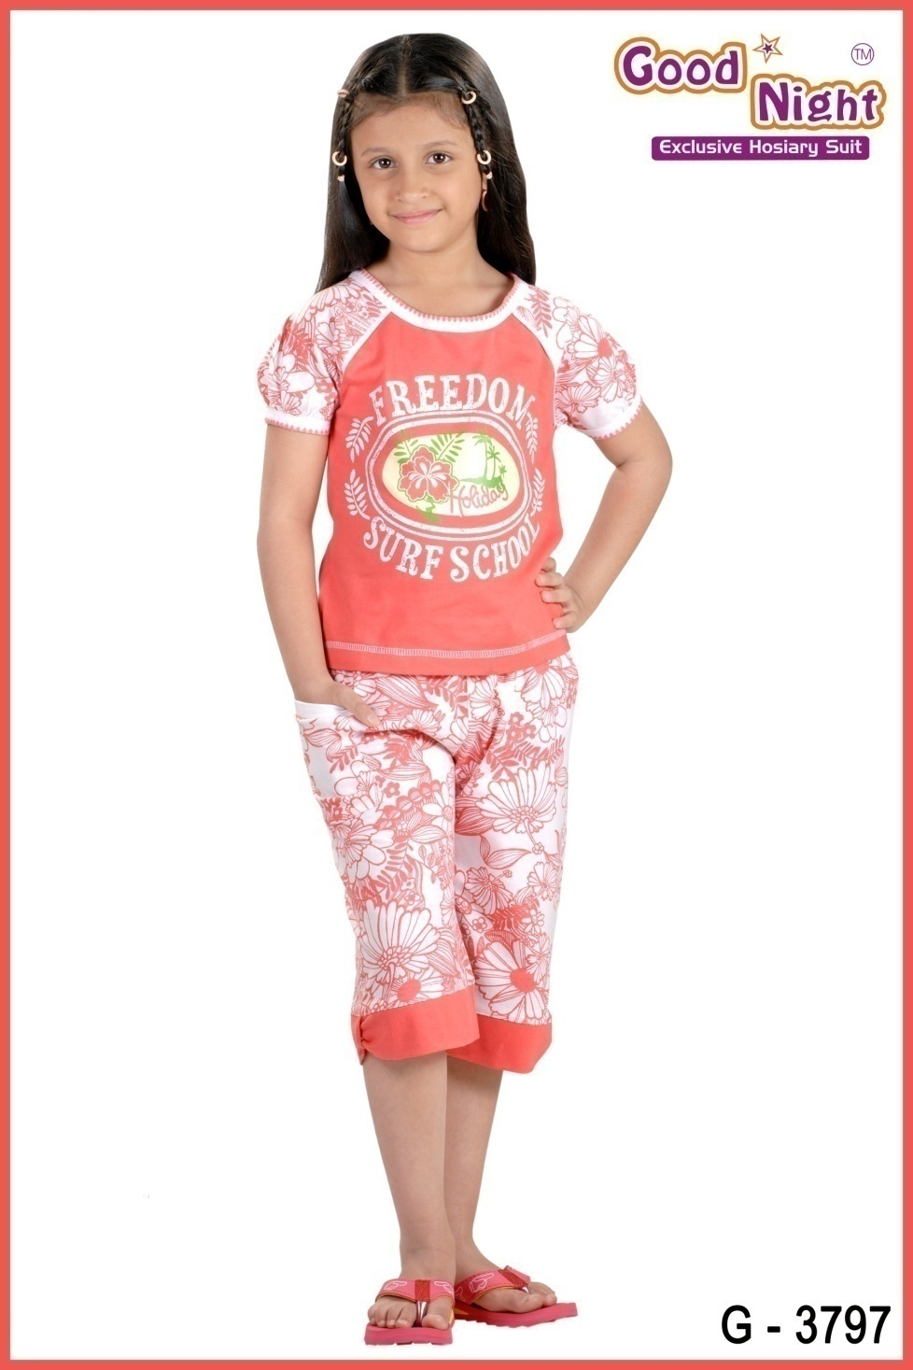
www.kaplind.com

Slide 25
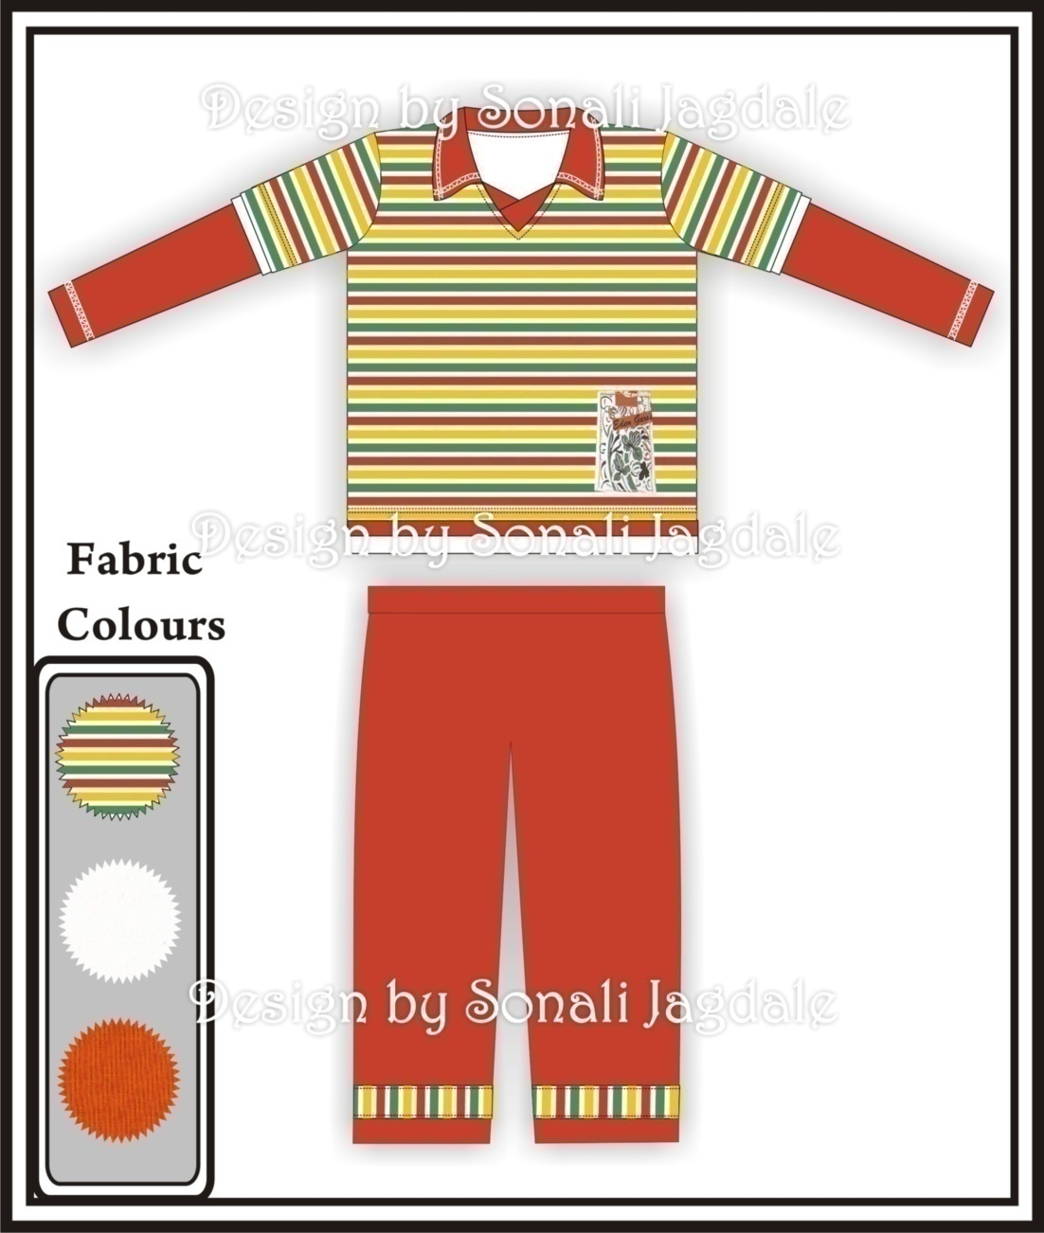
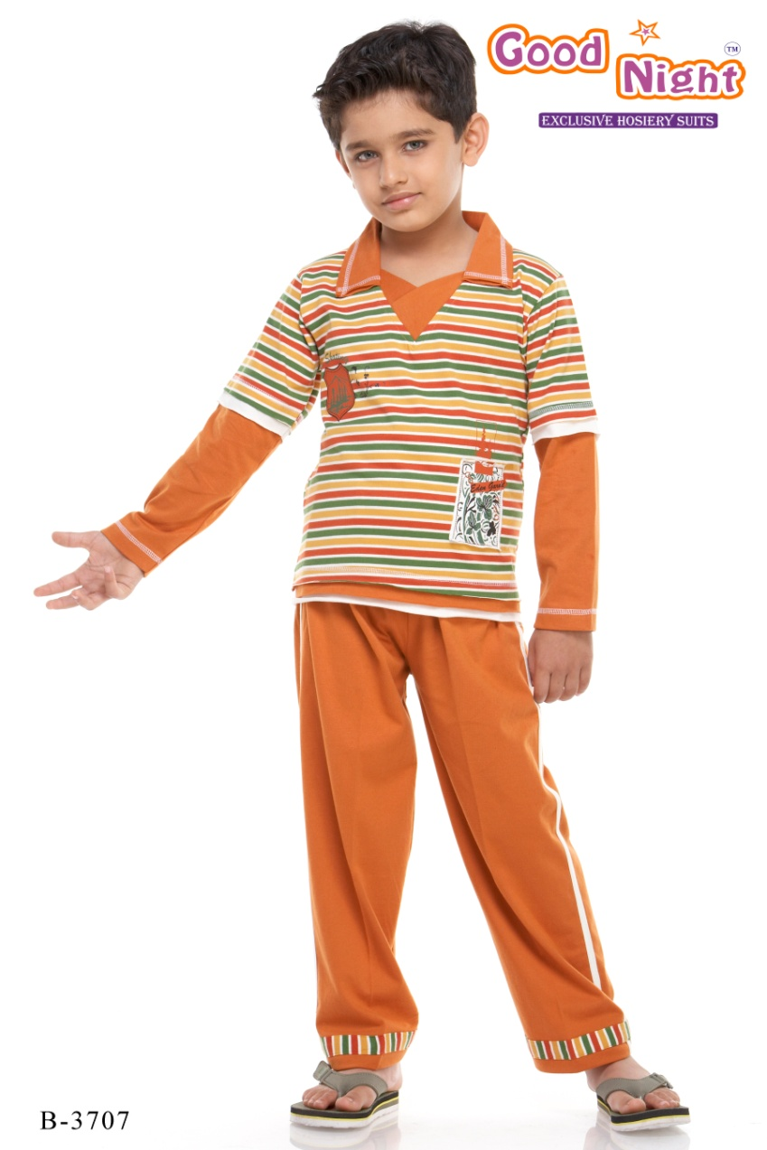
Autumn Winter - 2008
www.kaplind.com

Slide 26
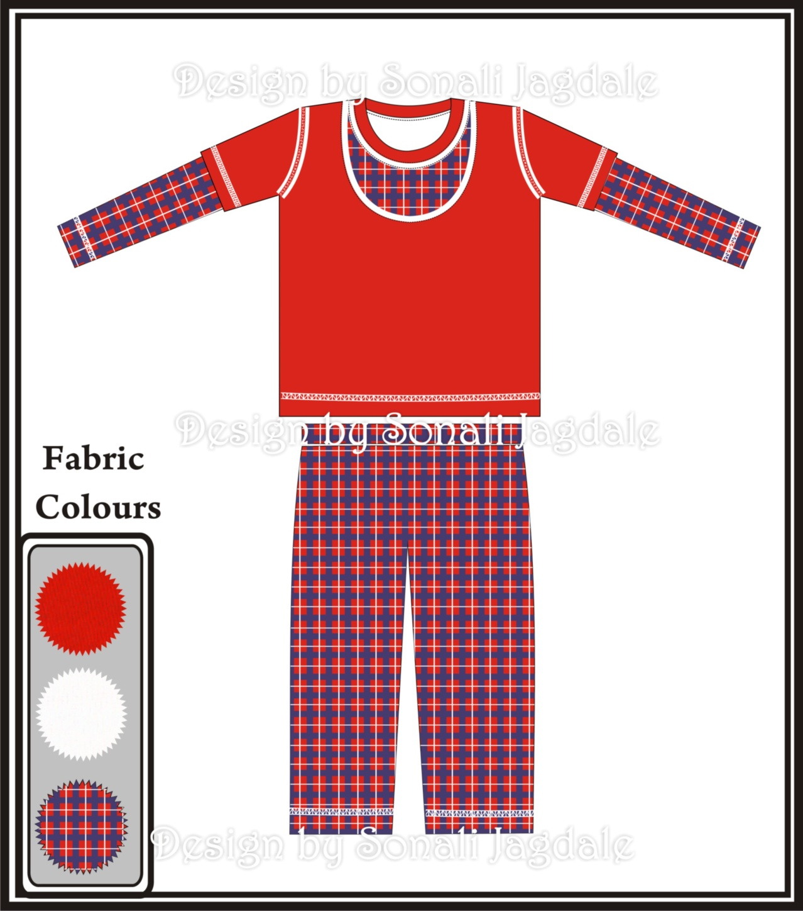
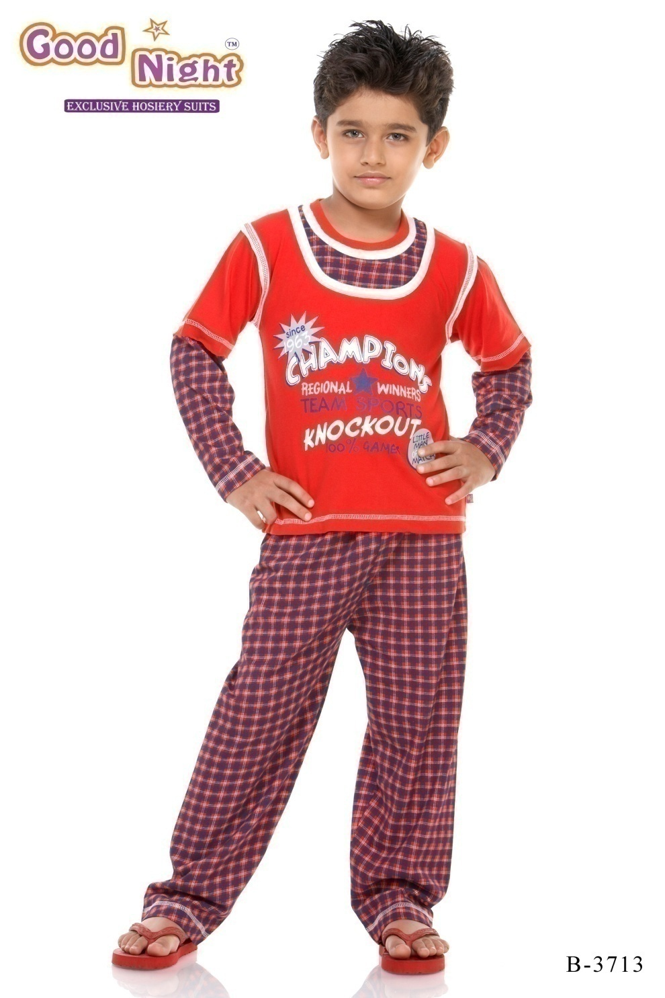
www.kaplind.com

Slide 27
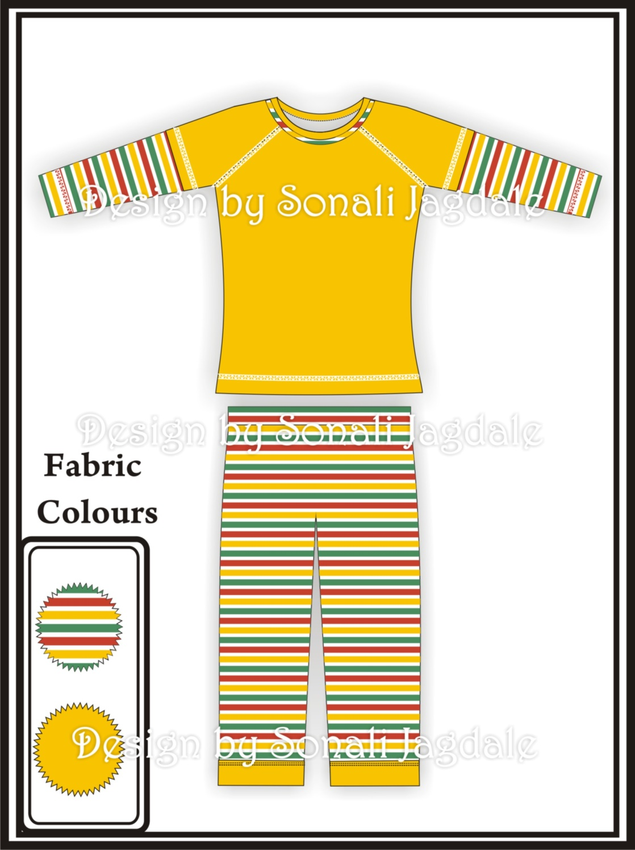

www.kaplind.com

Slide 28
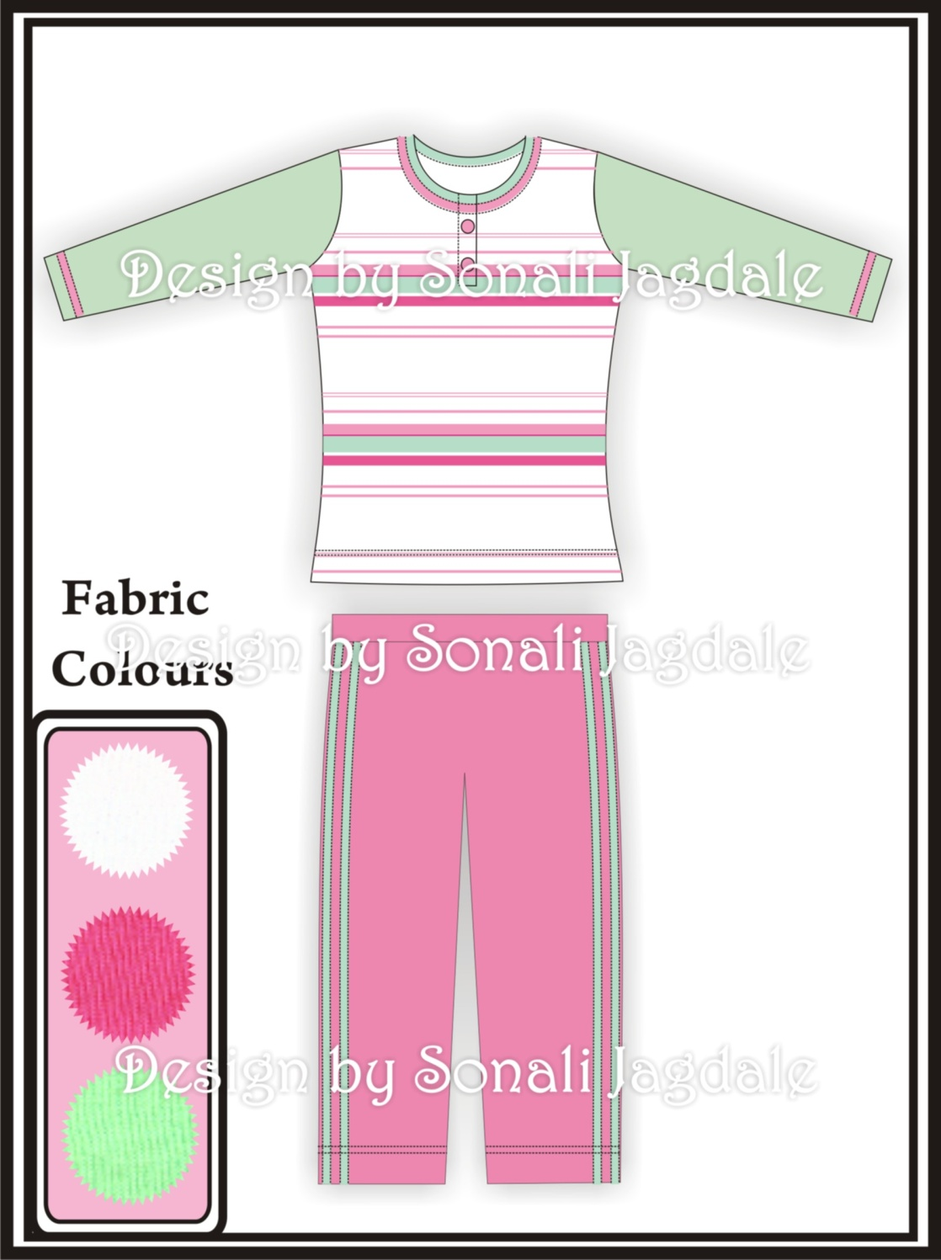
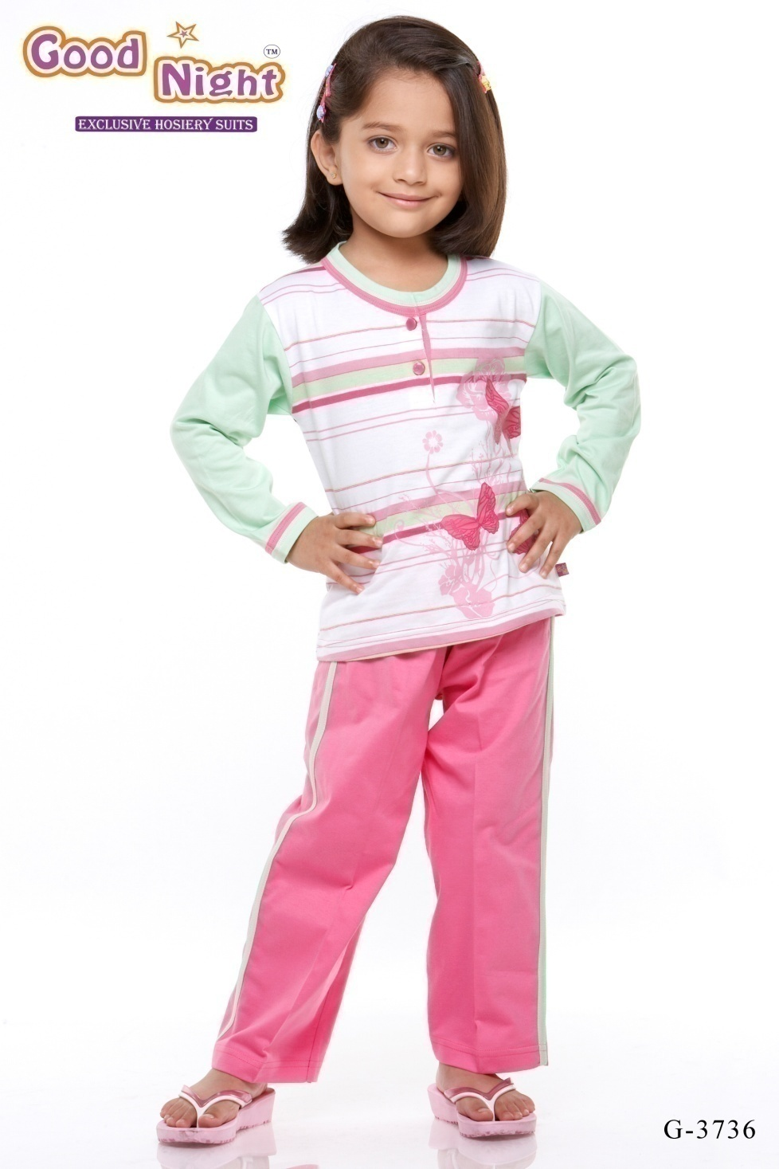
www.kaplind.com

Slide 29
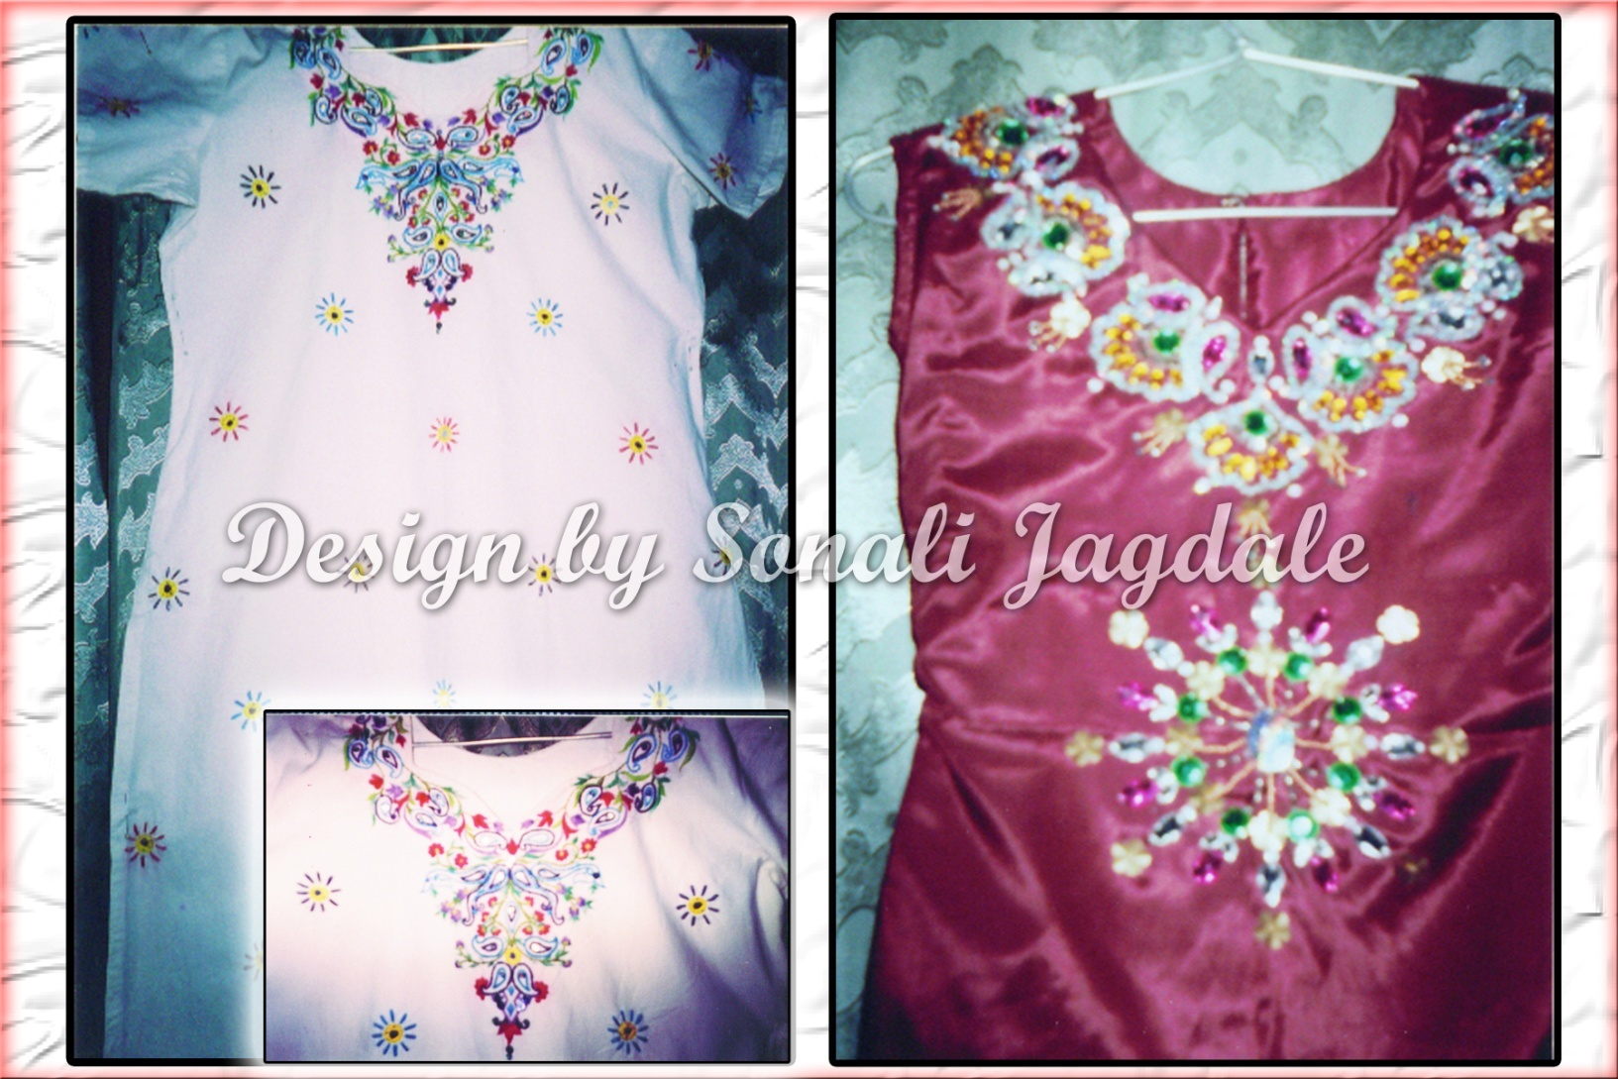
Computerize Art Designs

Slide 30

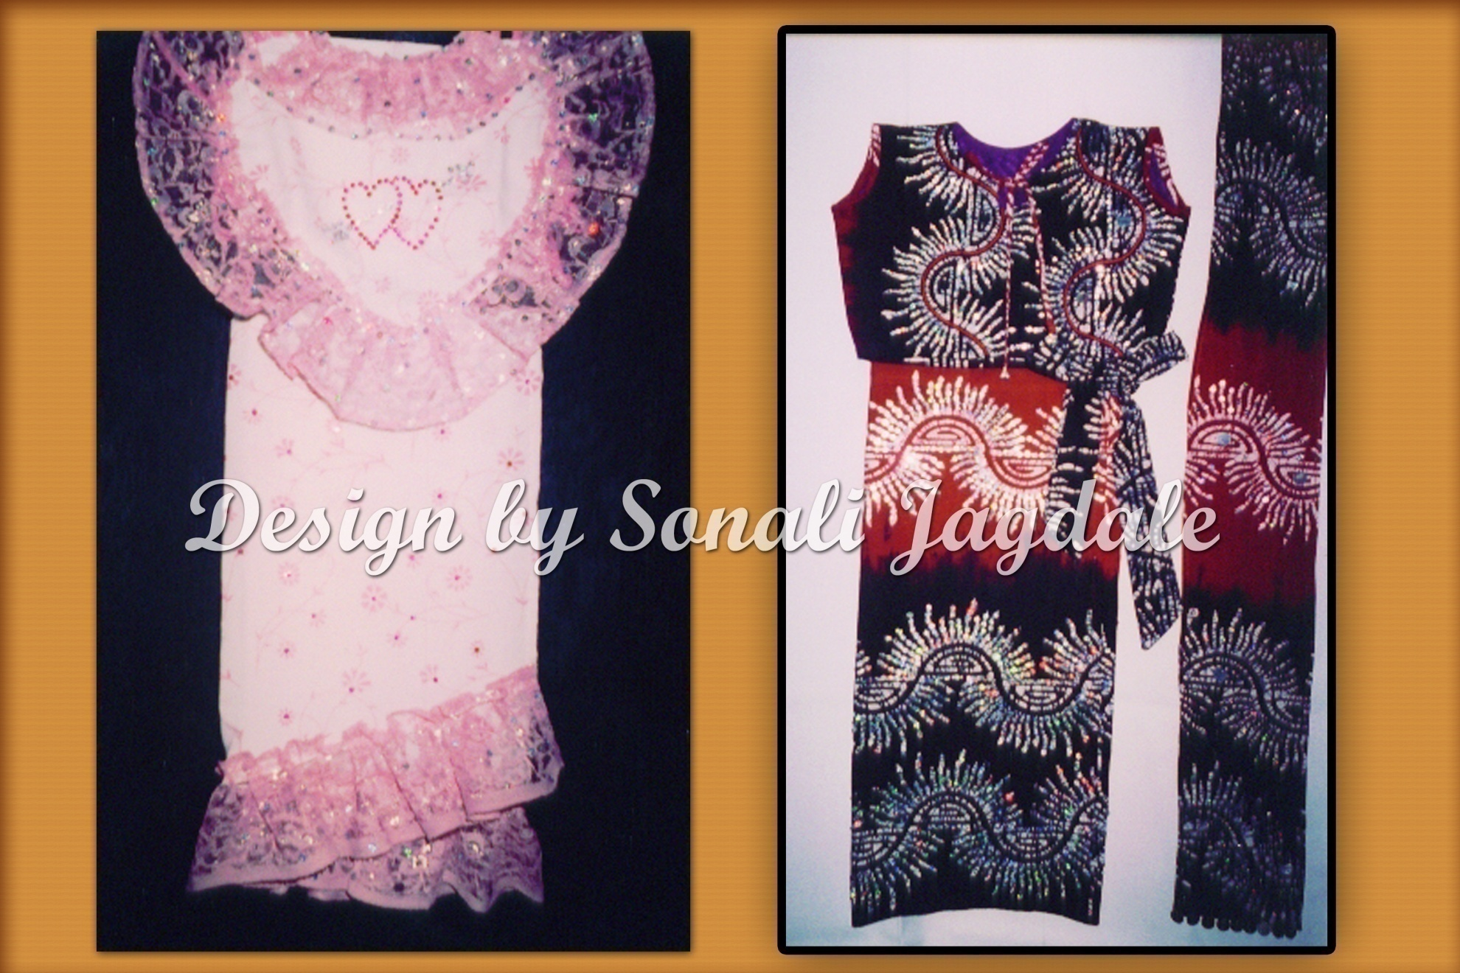


Sonali’s Creation

Slide 31
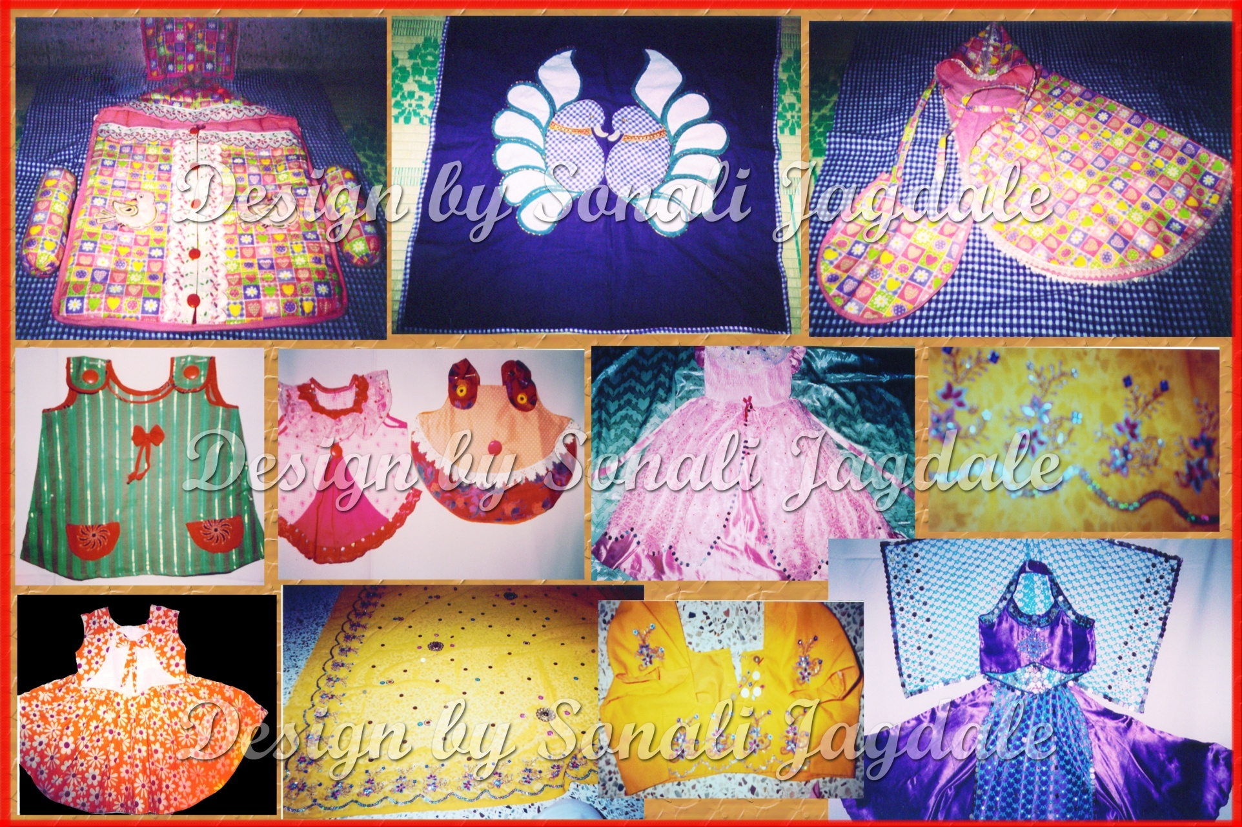

Slide 32


Thanks ,
Sonali Dilip Jagdale.
Contact No. : 9545440369
E-mail add. : jagdale_1sonali@yahoo.co.in

